Slide 1
Rules of Thumb
Practical ways of supporting people with dementia at the end of life
With thanks to:

Slide 3
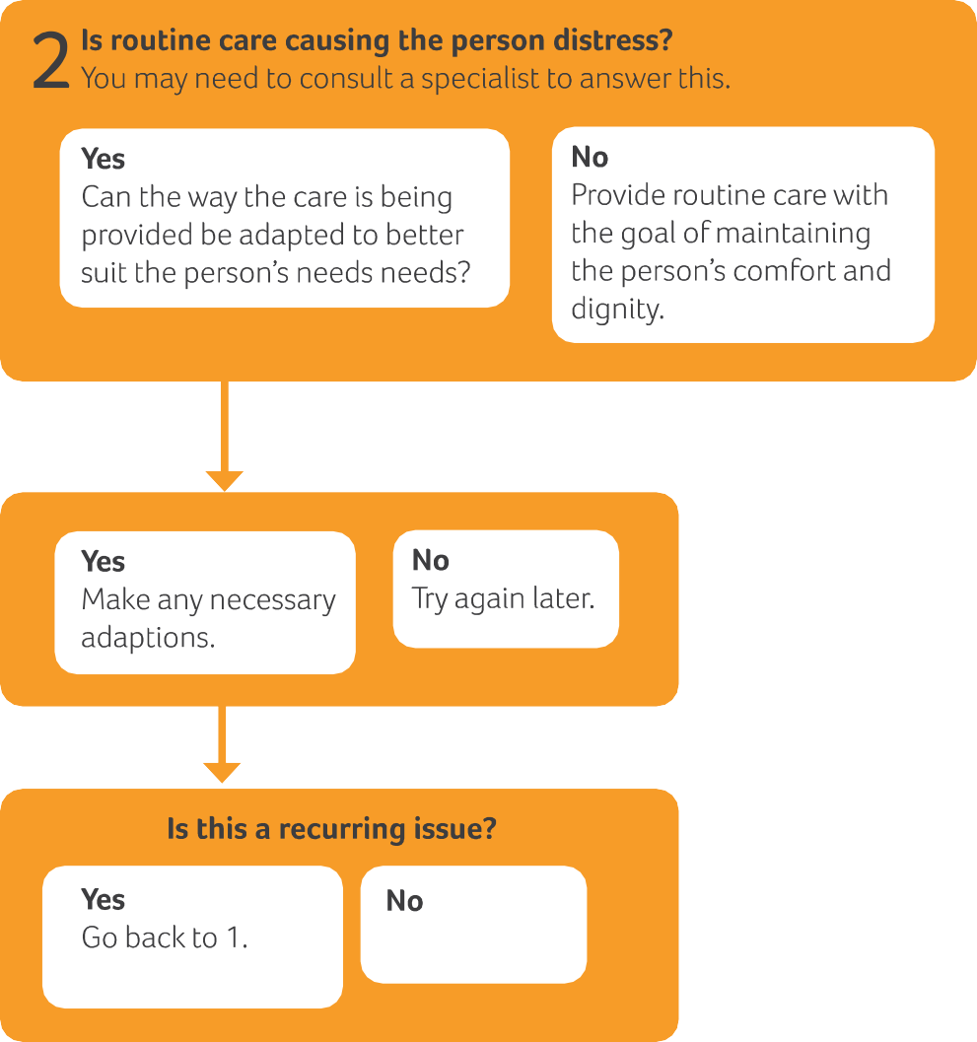

Slide 4
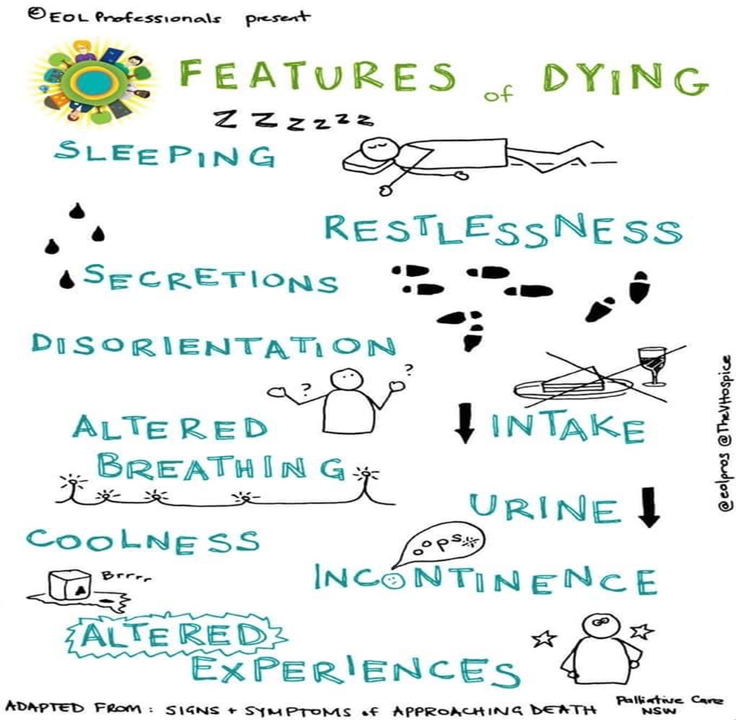
Recognising when a person is dying

Slide 5
Care at the end of life
What is routine care at the end of life?
What is essential?
What if it causes distress?

Slide 6
Routine care at the end of life
Includes:
Oral care
Washing and bathing
Changing bed sheets
Turning to prevent pressure sores or skin irritation
It should always involve kindness and maintaining dignity

Slide 7
Peter
As things progress how can we adapt our care to make it just right for Peter? (Personalisation)
What are the priorities?
Our previous knowledge of him means we know he would like a priest to visit and that he will enjoy some choral music.
His family can visit as often as they wish and staff encourage them to share their memories.
The staff hate to turn Peter when he is peaceful - What are the risks, benefits and burdens?
Who can help?

