Slide 1
Rules of Thumb
Practical ways of supporting people with dementia at the end of life
With thanks to:

Slide 3
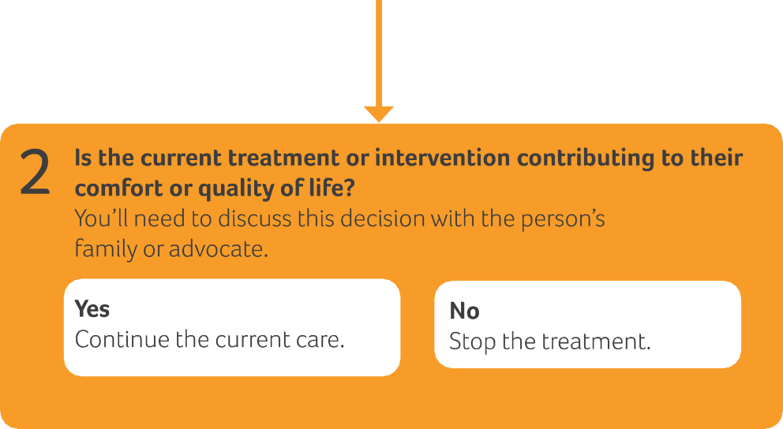
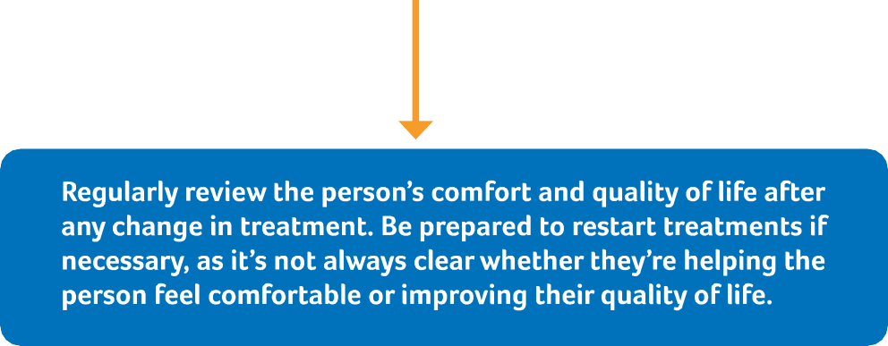

Slide 4
What is a treatment/intervention?
Definition - The use of an agent, procedure, or regimen, such as a drug, surgery, or exercise, in an attempt to cure or mitigate a disease (free-dictionary, 2021)
Can you give some examples?
Regular measurements, medications, physical observations, blood tests, cannulations, blood pressure monitoring

Slide 5
Peter
Peter’s swallowing difficulties continue and he starts to choke when trying to swallow his atorvastatin capsule.
What are the options? Covert medication? Review goals of treatment and stop atorvastatin?
How can we make these decisions?
Benefits risks and burdens
What should we do?

Slide 6
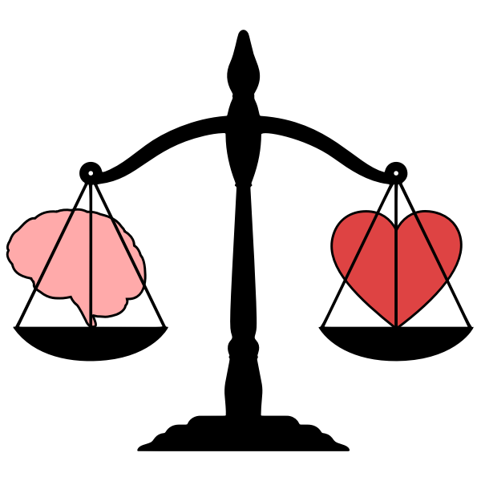
Assessing the overall benefit of treatment options Weighing the benefits, burdens and risks
The benefits of a treatment that may prolong life, improve a patient’s condition or manage their symptoms must be weighed against the burdens and risks for that patient, before you can reach a view about its overall benefit (GMC, 2020)

Slide 7
Weighing benefits, risks and burdens
Complete activity 3

Slide 8
Advance Care Planning
What you do want to happen
Preferred Priorities for Care document (PPC)
What music I would like to have on in my room
*This is a....
Advance Statement of wishes and preferences
What you do not want to happen
Do Not Attempt Cardio Pulmonary Resuscitation (DNACPR)
I don’t want artificial feeding (formalised)
This is a...
Advanced Directive to Refuse Treatment
Who will speak for you
Lasting Power of Attorney for health and welfare
Nominated proxy spokesperson
*This is a...
Proxy or Lasting Power of Attorney

Slide 9
Peter
As the months go by, Peter continues to lose weight and becomes more frail
His swallow worsens and he is bed bound; GP and care home feel he is reaching the end of his life. His family find this hard to take on board.
All of his medications are discontinued and we start to focus on symptom management: for example pain relief, regular turning and good mouth care
His Treatment Escalation Plan is adjusted to reflect the new priorities of care: not for hospital admission (except for fractures, serious head injuries or intractable symptoms)

Slide 10
The role of the Multi-disciplinary Team (MDT)
How do teams work together?
Resident and family advocate
GSF or palliative care meetings
The weekly ‘home round’ or ‘check in’, with residents prioritised for review based on MDT clinical judgement and care home advice
Referral to other teams or specialists
Developing team with specialist skills (further training, education)
Reflective meetings (example, Significant Event Analysis)

