Slide 1
Rules of Thumb
Practical ways of supporting people with dementia at the end of life
With thanks to:

Slide 3
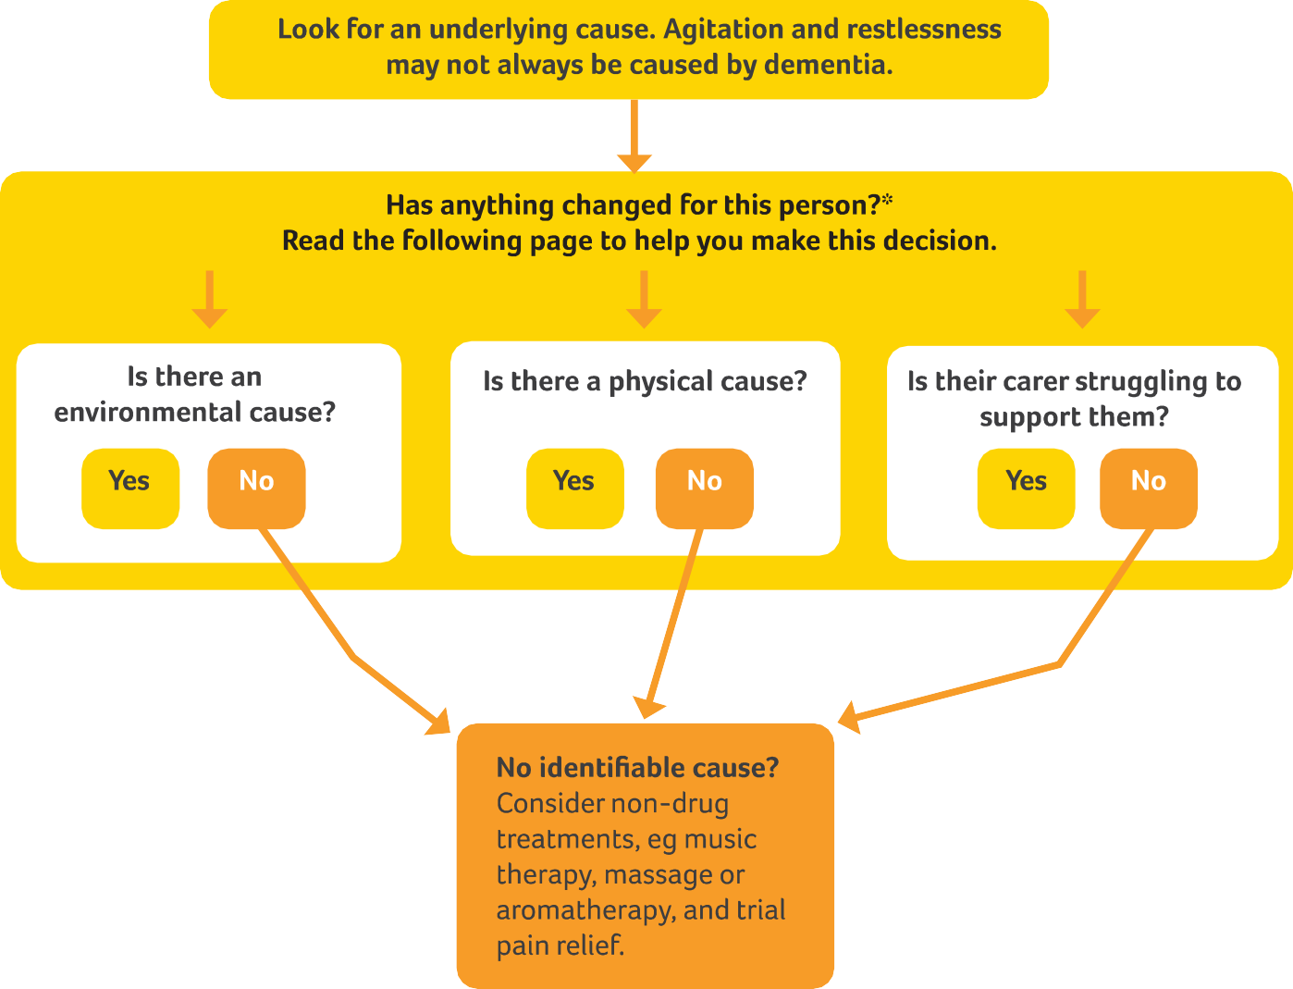
*You might want to speak to their family or
advocate to help establish this

Slide 4
Peter
Peter seems really settled for a few months and even joins in with the visiting choir and church services. One day he refuses breakfast and when his daughter comes with some lunch for him he pushes the plate onto the ground. Over the next few days he is very noisy and causing distress to other residents. He seems angry and everyone is on edge

Slide 5
Underlying causes
Complete activity 2a

Slide 6
Managing agitation and restlessness
Agitation may have several causes due to environment or social cause, physical cause or health or wellbeing of their carer
If a cause cannot be identified, a non-drug treatment should be considered. If these aren’t effective, specialist help should be sought to consider the use of medication
Remember this may be part of the dying process

Slide 7
Peter
When staff come in to help he continues to shout and kicks Flo who is trying to clear up. She rings the GP and says they need an urgent visit to provide sedation. GP cannot see any sign of infection and Peter is now on regular painkillers. The chef asks if he could be missing Malcolm who has been admitted to hospital the previous day
What should we do?

Slide 8
Risk assessment
Are you ok? Can you keep yourself safe?
Can you get some help?
Can you keep the resident safe?
How can risks be managed?

Slide 9
The triangle of care
Person with
Dementia
Professional
Carer
Carers Trust & RCN, 2016

Slide 10
Watch this video
What does it make you think?

Slide 11
"The best way to describe the unpaid carer is like the mortar in the wall. It's there, but it's hidden.“
Peter Charleton (2020) BBC Scotland news

Slide 12
Supporting carers
Complete activity 2b

Slide 13
*You might want to speak to their family or
advocate to help establish this

