Slide 1
Rules of Thumb
Practical ways of supporting people with dementia at the end of life
With thanks to:

Slide 3
Meet Peter
Peter is an 85 yo gentleman who has recently moved into a care home He has dementia and Type 2 diabetes and had a heart attack 5 years ago.
He had been living at home with his family until his wife fell ill and he came to the care home for respite before converting to a permanent residential placement

Slide 4
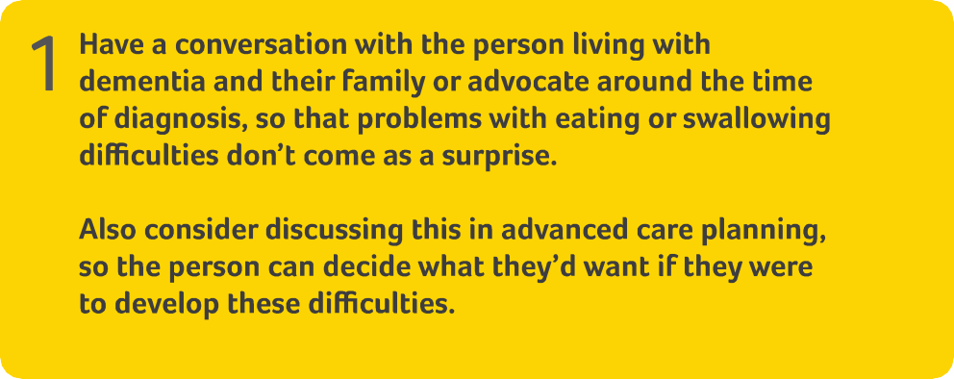
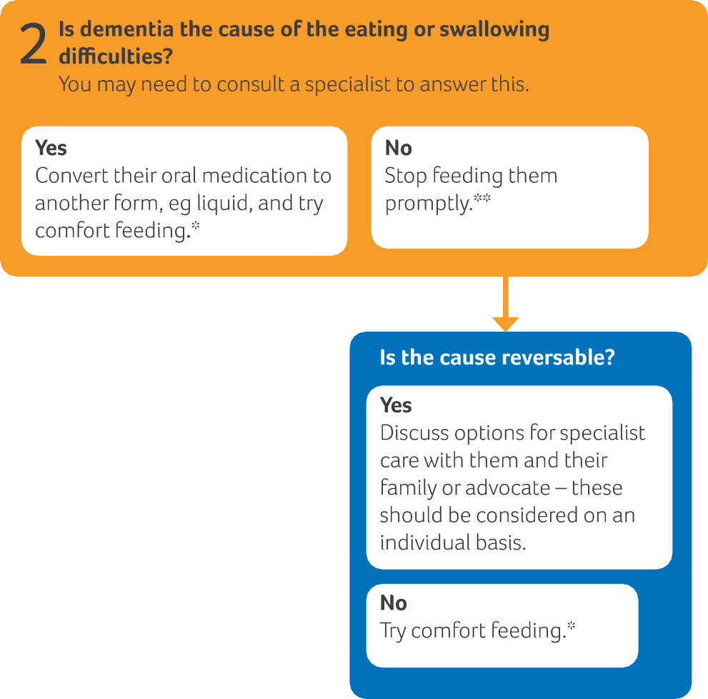
*This may carry associated risks of aspiration
**Closely observe their intake, especially if
changes to their swallow function are suspected

Slide 5
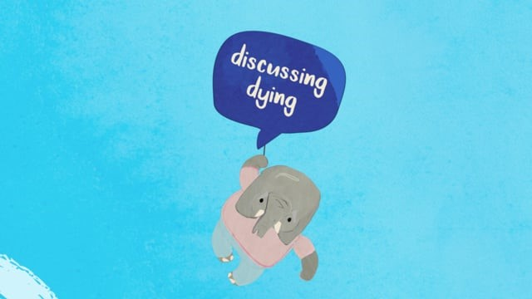
Don’t let it be a surprise
Dysphagia is reported in 13-57% people living with different types of dementia, increasing towards the time of death¹
Loss of appetite and difficulties with eating and maintaining weight are almost universal and expected complications of progressive dementia²
Have a conversation with the person living with dementia and their family or advocate around the time of diagnosis so that problems with eating or swallowing difficulties don’t come as a surprise. If this hasn’t been done, find out what they know, and offer the opportunity for them to discuss this

Slide 6
How do we elicit concerns?
What do you understand about what has happened so far? PAST
What do you understand about what is happening now? PRESENT
What do you think may happen in the future? FUTURE

Slide 7
What may cause eating or swallowing difficulties?
Physical health issues like pain and constipation dental problems oral thrush
Psychological causes such as anxiety and depression
Progressive effects of dementia on brain: appetite/co-ordination of swallowing
Eating too quickly
Change in food preferences
Practical issues: White fish and potato on white plate, no dentures, inappropriate utensils… would you eat it???
Distracted by TV noise

Slide 8
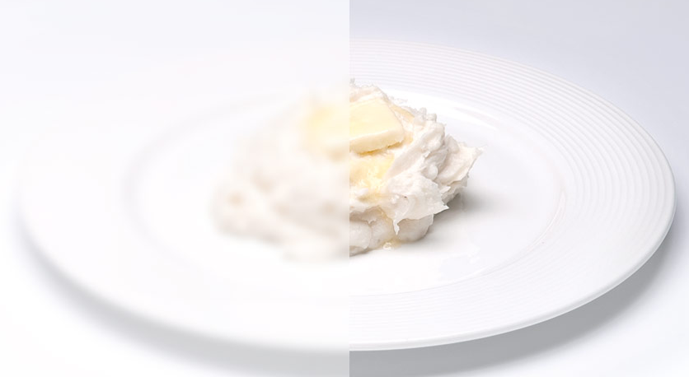
Practical issues
Eyesight loss causing blurring of food – further issue
Distracted by noise

Slide 9
Main types of artificial feeding
Nasogastric (NG) tube. This tube is placed through the nose and down into the stomach and sends liquid food directly to the stomach
Gastrostomy tube (G-tube) or percutaneous endoscopic gastrostomy tube (PEG tube). This tube is placed through a small hole in the stomach and sends liquid food directly into the stomach
IV tube. This tube is placed into a vein and sends liquid food directly into the blood vessels LESS COMMON IN CHRONIC SITUATIONS

Slide 10
Considerations of artificial feeding
Are there any alternatives?
Is this temporary?
Would it affect the person’s dignity or be against their beliefs?
Would they have chosen to be fed or hydrated artificially if they could have foreseen the situation?
Would the person’s quality of life be improved if they were artificially fed?
Would artificial food or fluids cause them distress or make them uncomfortable?
(Alzheimer's Society)

Slide 11
What do we know about Peter’s wishes
Advance Care Planning
What you do want to happen
Preferred Priorities for Care document (PPC)
What music I would like to have on in my room
*This is a....
Advance Statement of wishes and preferences
What you do not want to happen
Do Not Attempt Cardio Pulmonary Resuscitation (DNACPR)
I don’t want artificial feeding (formalised)
This is a...
Advanced Directive to Refuse Treatment
Who will speak for you
Lasting Power of Attorney for health and welfare
Nominated proxy spokesperson
*This is a...
Proxy or Lasting Power of Attorney
?? Lasting Power of Attorney for property and financial affairs
?? Best Interest Discussion
?? Respect document

Slide 12
Peter
Peter has lost weight over the last 6 weeks and isn’t eating very much. Despite the best efforts of the chef and his family, he still seems disinterested in his food. He is diagnosed with depression and things do improve when he starts sertraline. He is observed laughing together with another resident, Malcolm. In spite of this the volume that he eats reduces gradually and his daughter is frightened he will starve to death
What should we do?

Slide 13
Comfort feeding An example of a comfort feeding care plan
Offer food and liquid as long as it is not distressing
Feed with the least invasive and potentially most satisfying method
Provide continuous interaction with the patient (e.g., calm environment, thorough mouth care, conversation, therapeutic touch)

Slide 14
*This may carry associated risks of aspiration
**Closely observe their intake, especially if
changes to their swallow function are suspected

