Slide 1







Rules of Thumb
Practical ways of supporting people with dementia at the end of life
With thanks to:

Slide 2
Rules of Thumb
Introduction

Slide 3

What does end of life mean in dementia?
A period of time when the person, their family or healthcare professionals recognise that the person might be in the last phase of their life. This will vary for different people
Rules of Thumb Guide (2020)

Slide 4

Why is it difficult to identify dying?
The person is likely to have difficulty in communicating any issues, relying on external judgement of their condition
The variable nature of the progression of dementia
Deterioration can be sudden and unpredictable
OR…
A decline can happen so gradually that people do not link the person’s eventual death with dementia (…see next slide)

Slide 5
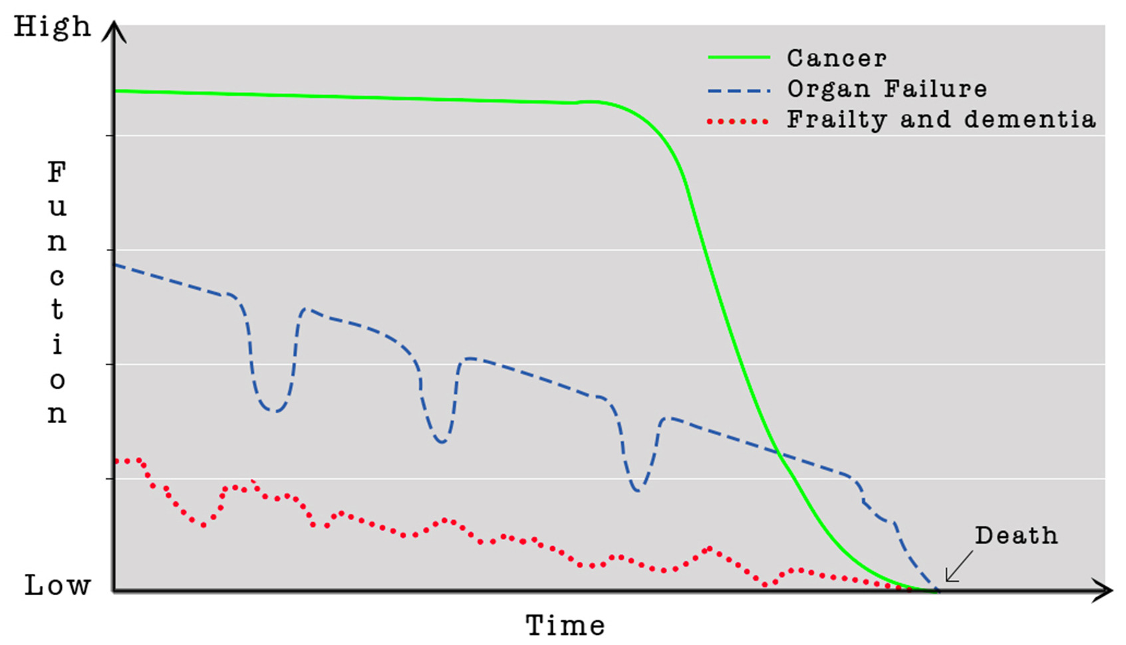

The course of illness
Based On Lynn & Adamson, 2003

Slide 6
What does this mean?
The average life expectancy from diagnosis to death for dementia is 4.5 years¹ but many people live for 8 years and some for 20 years after diagnosis
Half of people with advanced dementia will die within 1.3 years
One quarter of those with advanced dementia will die within 6 months
Most people with advanced dementia do not die from devastating acute events, such as heart attack
KEY MESSAGE… “Consider needs vs. prognosis”

Slide 7
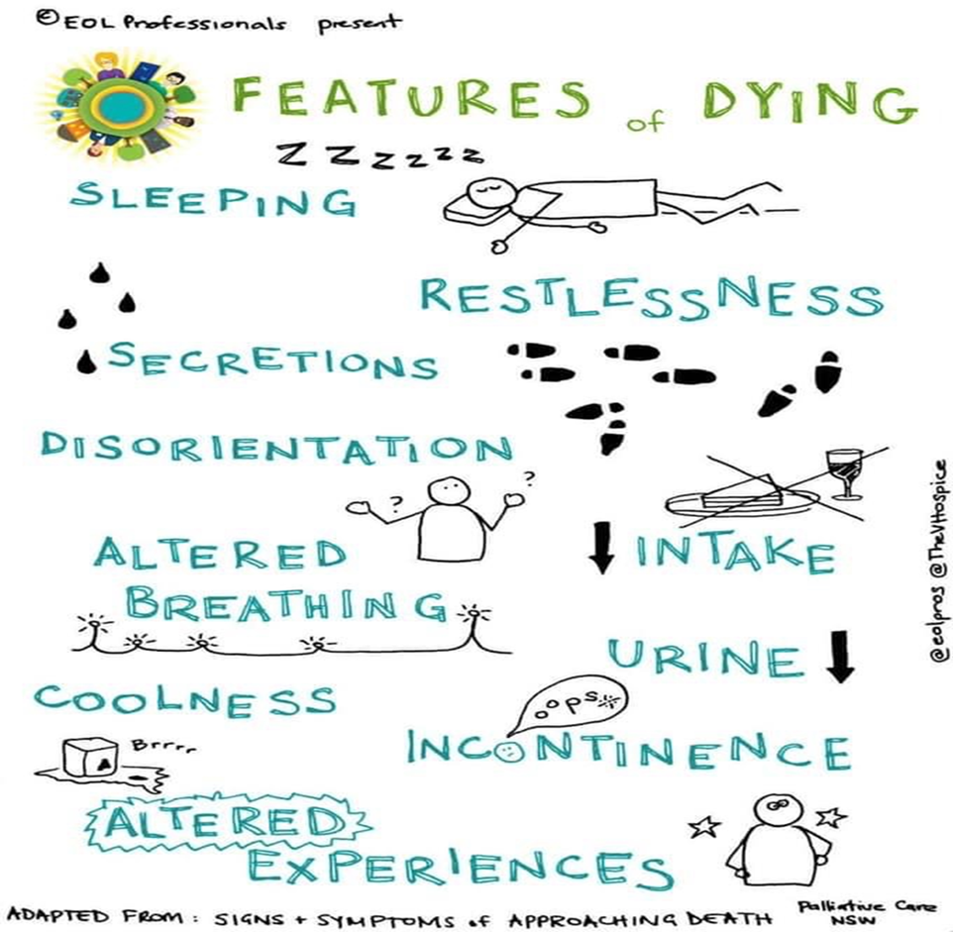
How do we identify when the very end of life is approaching?

Slide 8

Who should be involved in care decisions?
Whenever possible try to include the person with dementia in any new decisions, at each stage of their care.
If the person is able to make decisions, consider advance care planning. If this is not the case, have they completed and advance care planning previously….
Complete activity 1

Slide 9
Activity 1
Advance Care Planning
What you do want to happen
Preferred Priorities for Care document (PPC)
What music I would like to have on in my room
*This is a....
Advance Statement of wishes and preferences
What you do not want to happen
Do Not Attempt Cardio Pulmonary Resuscitation (DNACPR)
I don’t want artificial feeding (formalised)
This is a...
Advanced Directive to Refuse Treatment
Who will speak for you
Lasting Power of Attorney for health and welfare
Nominated proxy spokesperson
*This is a...
Proxy or Lasting Power of Attorney
?? Lasting Power of Attorney for property and financial affairs
?? Best Interest Discussion
?? Respect document

Slide 10
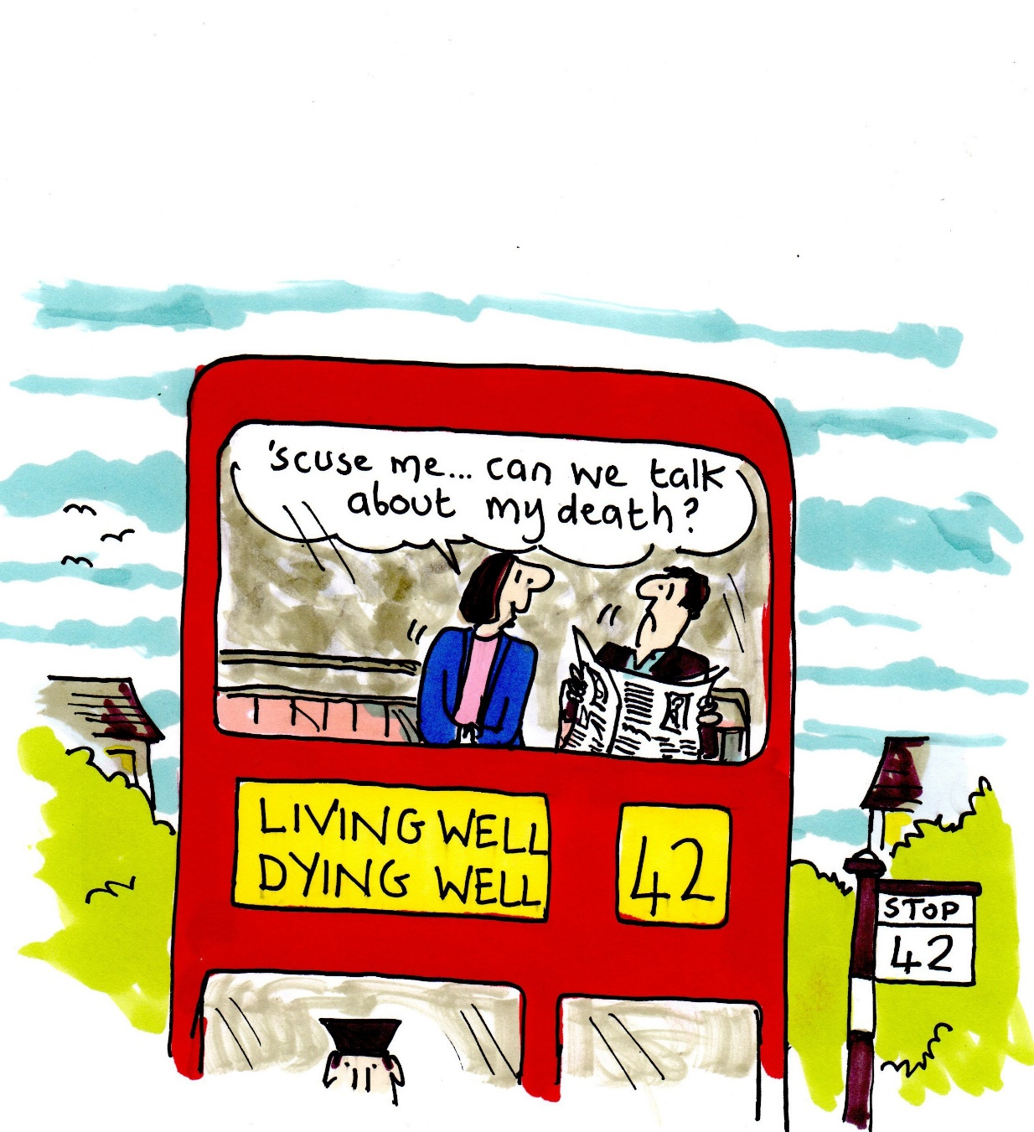
The importance of communicating decisions and plans

