Slide 1







Rules of Thumb
Practical ways of supporting people with dementia at the end of life
With thanks to:

Slide 2
Welcome
Whilst your waiting for the session to start, please can you do two things:
In the chat box please state your name and role so that everyone is aware of who is attending
If we haven’t already got your email address and you are happy to share it, can you also put it in the chat box with your name and role, so we can send out your certificate

Slide 3

Housekeeping
Please stay on mute unless you wish to speak
Use the if you would like to speak
We would like you to get to know each other and build relationships, so please use the to comment questions
If you have any resources, please add to
We will have a comfort break – please don't log off, just switch off your camera and microphone
Finally we hope you enjoy the session but please remember to complete the post-course questionnaire

Slide 4





Icons you will see throughout the presentation
Peter – a case study
Discuss
Quiz or question
Reflect
Activity

Slide 5
Ground rules

Slide 6
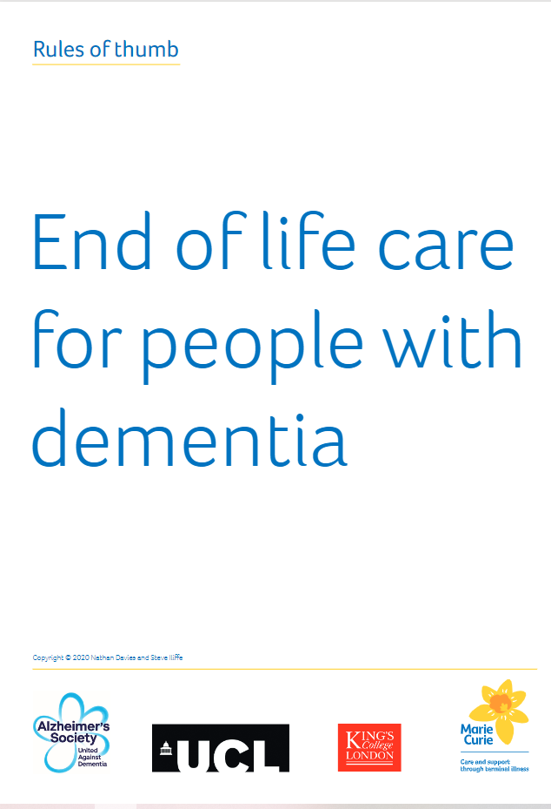
Who’s this guide for?
This guide has been created for any healthcare professionals providing care and support for people with dementia at the end of life.
It can be used for training, to support decision-making, and help you have discussions with family members and advocates

Slide 7
Rules of Thumb

Slide 8
Rules of Thumb
Introduction

Slide 9

What does end of life mean in dementia?
A period of time when the person, their family or healthcare professionals recognise that the person might be in the last phase of their life. This will vary for different people
Rules of Thumb Guide (2020)

Slide 10

Why is it difficult to identify dying?
The person is likely to have difficulty in communicating any issues, relying on external judgement of their condition
The variable nature of the progression of dementia
Deterioration can be sudden and unpredictable
OR…
A decline can happen so gradually that people do not link the person’s eventual death with dementia (…see next slide)

Slide 11
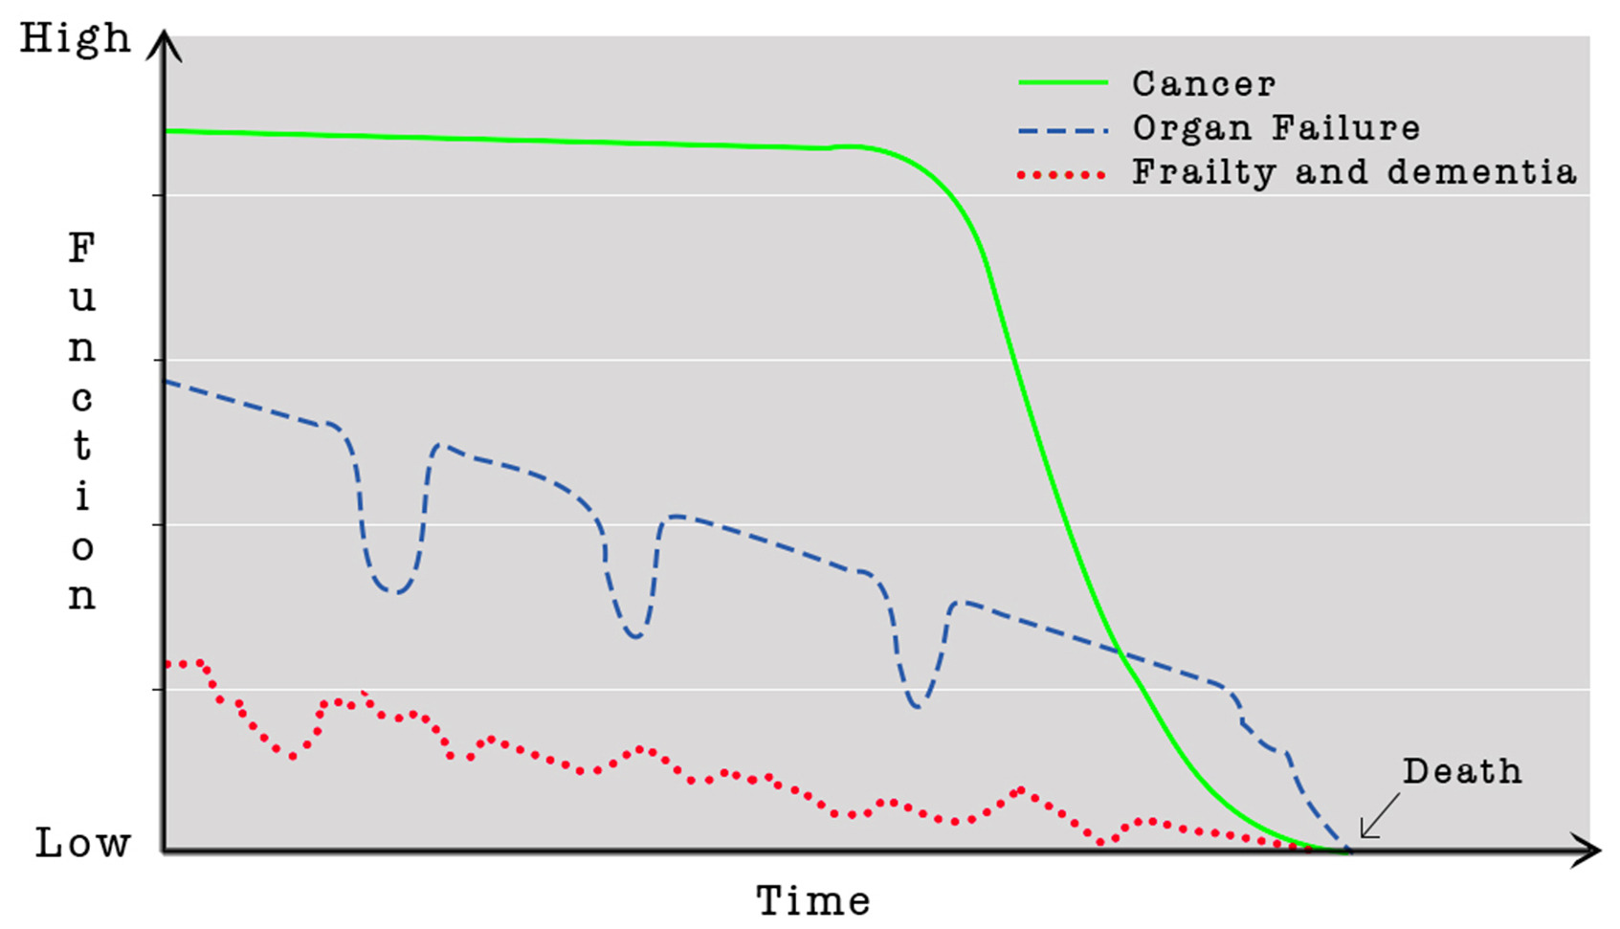

The course of illness
Based On Lynn & Adamson, 2003

Slide 12
What does this mean?
The average life expectancy from diagnosis to death for dementia is 4.5 years¹ but many people live for 8 years and some for 20 years after diagnosis
Half of people with advanced dementia will die within 1.3 years
One quarter of those with advanced dementia will die within 6 months
Most people with advanced dementia do not die from devastating acute events, such as heart attack
KEY MESSAGE… “Consider needs vs. prognosis”

Slide 13
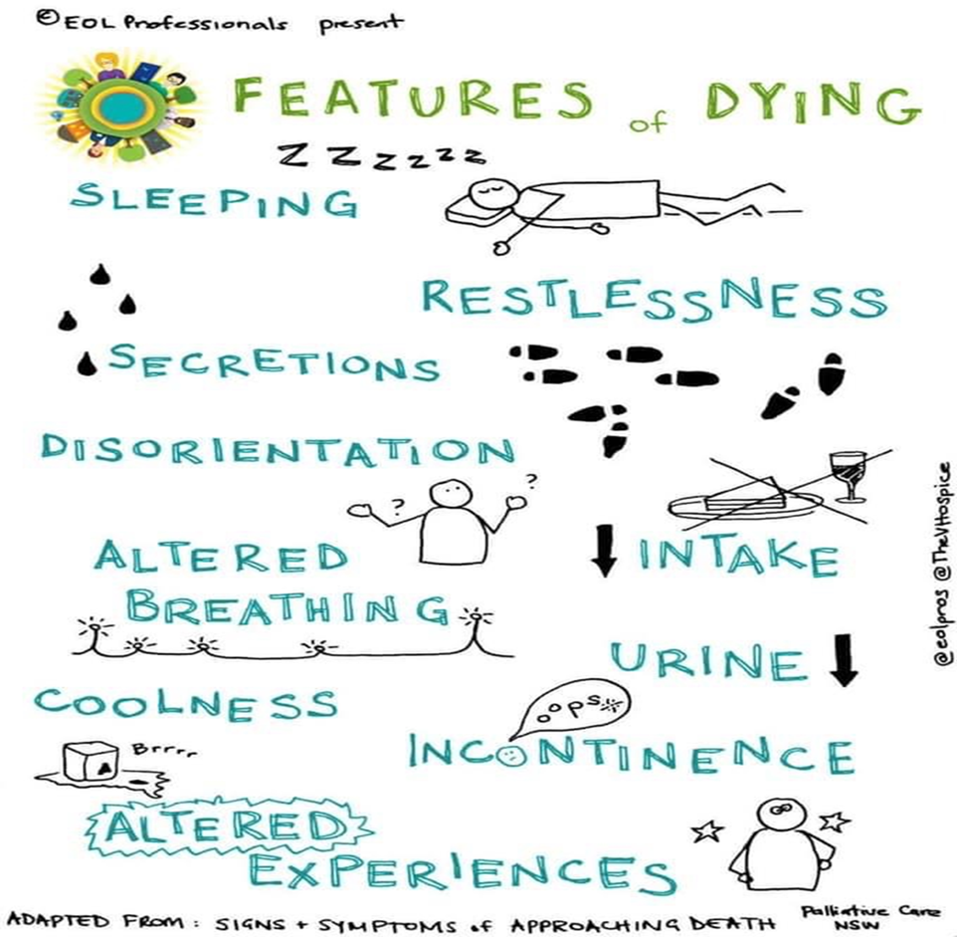
How do we identify when the very end of life is approaching?

Slide 14
Who should be involved in care decisions?
Whenever possible try to include the person with dementia in any new decisions, at each stage of their care.
If the person is able to make decisions, consider advance care planning. If this is not the case, have they completed and advance care planning previously….
Complete activity 1

Slide 15
Activity 1
Advance Care Planning
What you do want to happen
Preferred Priorities for Care document (PPC)
What music I would like to have on in my room
*This is a....
Advance Statement of wishes and preferences
What you do not want to happen
Do Not Attempt Cardio Pulmonary Resuscitation (DNACPR)
I don’t want artificial feeding (formalised)
This is a...
Advanced Directive to Refuse Treatment
Who will speak for you
Lasting Power of Attorney for health and welfare
Nominated proxy spokesperson
*This is a...
Proxy or Lasting Power of Attorney
?? Lasting Power of Attorney for property and financial affairs
?? Best Interest Discussion
?? Respect document

Slide 16
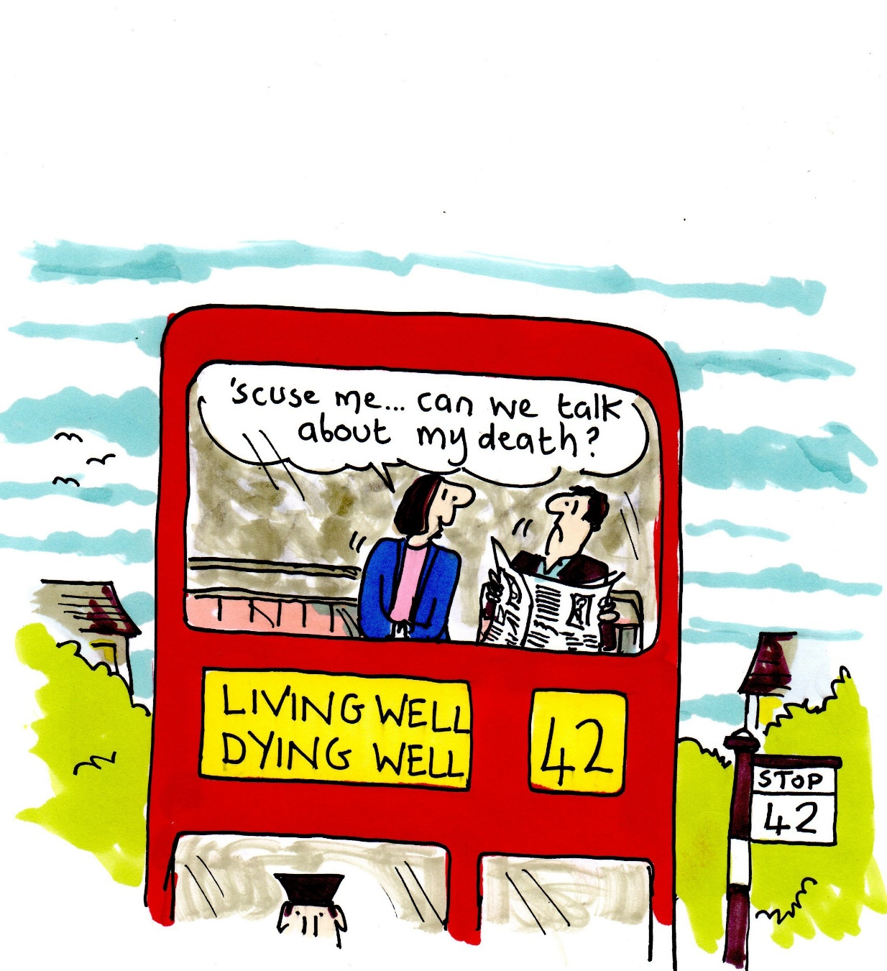
The importance of communicating decisions and plans

Slide 18

Meet Peter
Peter is an 85 yo gentleman who has recently moved into a care home He has dementia and Type 2 diabetes and had a heart attack 5 years ago.
He had been living at home with his family until his wife fell ill and he came to the care home for respite before converting to a permanent residential placement

Slide 19
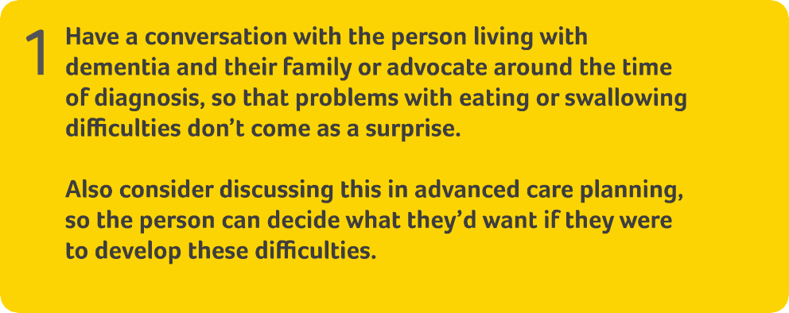
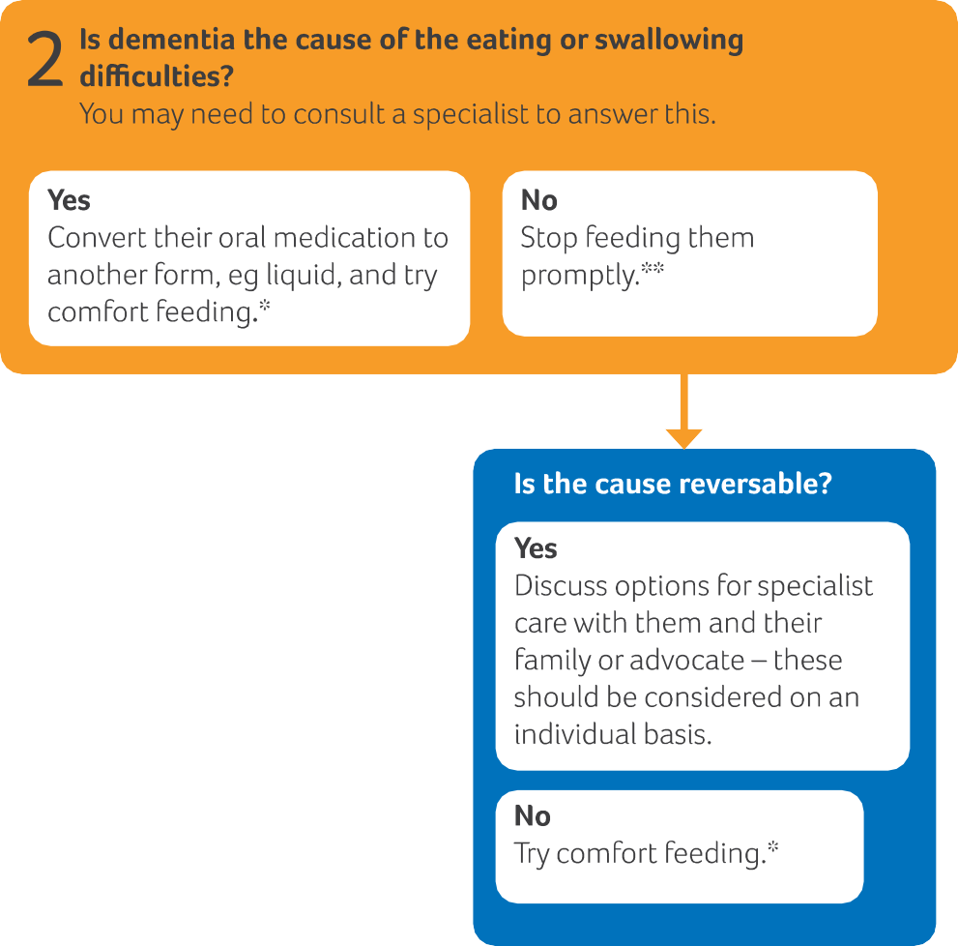
*This may carry associated risks of aspiration
**Closely observe their intake, especially if
changes to their swallow function are suspected

Slide 20
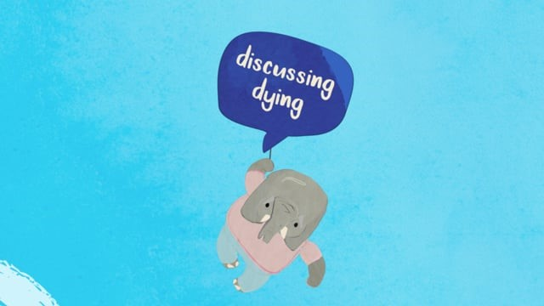
Don’t let it be a surprise
Dysphagia is reported in 13-57% people living with different types of dementia, increasing towards the time of death¹
Loss of appetite and difficulties with eating and maintaining weight are almost universal and expected complications of progressive dementia²
Have a conversation with the person living with dementia and their family or advocate around the time of diagnosis so that problems with eating or swallowing difficulties don’t come as a surprise. If this hasn’t been done, find out what they know, and offer the opportunity for them to discuss this

Slide 21
How do we elicit concerns?
What do you understand about what has happened so far? PAST
What do you understand about what is happening now? PRESENT
What do you think may happen in the future? FUTURE

Slide 22
What may cause eating or swallowing difficulties?
Physical health issues like pain and constipation dental problems oral thrush
Psychological causes such as anxiety and depression
Progressive effects of dementia on brain: appetite/co-ordination of swallowing
  Eating too quickly
  Change in food preferences
Practical issues: White fish and potato on white plate, no dentures, inappropriate utensils… would you eat it???
  Distracted by TV noise

Slide 23

Practical issues
Eyesight loss causing blurring of food – further issue
Distracted by noise

Slide 24
Main types of artificial feeding
Nasogastric (NG) tube. This tube is placed through the nose and down into the stomach and sends liquid food directly to the stomach
Gastrostomy tube (G-tube) or percutaneous endoscopic gastrostomy tube (PEG tube). This tube is placed through a small hole in the stomach and sends liquid food directly into the stomach
IV tube. This tube is placed into a vein and sends liquid food directly into the blood vessels LESS COMMON IN CHRONIC SITUATIONS

Slide 25
Considerations of artificial feeding
Are there any alternatives?
Is this temporary?
Would it affect the person’s dignity or be against their beliefs?
Would they have chosen to be fed or hydrated artificially if they could have foreseen the situation?
Would the person’s quality of life be improved if they were artificially fed?
Would artificial food or fluids cause them distress or make them uncomfortable?
(Alzheimer's Society)

Slide 26
What do we know about Peter’s wishes
Advance Care Planning
What you do want to happen
Preferred Priorities for Care document (PPC)
What music I would like to have on in my room
*This is a....
Advance Statement of wishes and preferences
What you do not want to happen
Do Not Attempt Cardio Pulmonary Resuscitation (DNACPR)
I don’t want artificial feeding (formalised)
This is a...
Advanced Directive to Refuse Treatment
Who will speak for you
Lasting Power of Attorney for health and welfare
Nominated proxy spokesperson
*This is a...
Proxy or Lasting Power of Attorney
?? Lasting Power of Attorney for property and financial affairs
?? Best Interest Discussion
?? Respect document

Slide 27
Peter
Peter has lost weight over the last 6 weeks and isn’t eating very much. Despite the best efforts of the chef and his family, he still seems disinterested in his food. He is diagnosed with depression and things do improve when he starts sertraline. He is observed laughing together with another resident, Malcolm. In spite of this the volume that he eats reduces gradually and his daughter is frightened he will starve to death
What should we do?

Slide 28
Comfort feeding
An example of a comfort feeding care plan
Offer food and liquid as long as it is not distressing
Feed with the least invasive and potentially most satisfying method
Provide continuous interaction with the patient (e.g., calm environment, thorough mouth care, conversation, therapeutic touch)

Slide 29
*This may carry associated risks of aspiration
**Closely observe their intake, especially if
changes to their swallow function are suspected

Slide 31
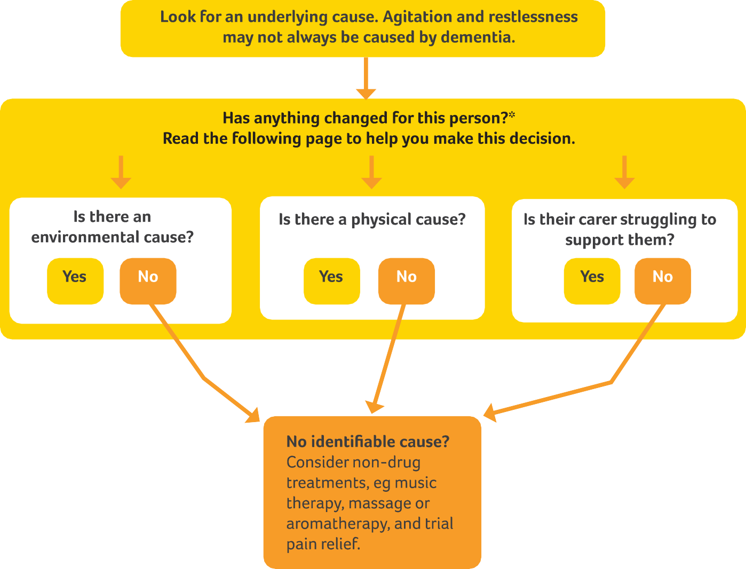
*You might want to speak to their family or
advocate to help establish this

Slide 32
Peter
Peter seems really settled for a few months and even joins in with the visiting choir and church services. One day he refuses breakfast and when his daughter comes with some lunch for him he pushes the plate onto the ground. Over the next few days he is very noisy and causing distress to other residents. He seems angry and everyone is on edge

Slide 33

Underlying causes
Complete activity 2a

Slide 34
Managing agitation and restlessness
Agitation may have several causes due to environment or social cause, physical cause or health or wellbeing of their carer
If a cause cannot be identified, a non-drug treatment should be considered. If these aren’t effective, specialist help should be sought to consider the use of medication
Remember this may be part of the dying process

Slide 35
Peter
When staff come in to help he continues to shout and kicks Flo who is trying to clear up. She rings the GP and says they need an urgent visit to provide sedation. GP cannot see any sign of infection and Peter is now on regular painkillers. The chef asks if he could be missing Malcolm who has been admitted to hospital the previous day
What should we do?

Slide 36
Risk assessment
Are you ok? Can you keep yourself safe?
Can you get some help?
Can you keep the resident safe?
How can risks be managed?

Slide 37
The triangle of care
Person with
Dementia
Professional
Carer
Carers Trust & RCN, 2016

Slide 38

Watch this video
What does it make you think?

Slide 39

"The best way to describe the unpaid carer is like the mortar in the wall. It's there, but it's hidden.“
Peter Charleton (2020) BBC Scotland news

Slide 40
Supporting carers
Complete activity 2b

Slide 41
*You might want to speak to their family or
advocate to help establish this

Slide 43
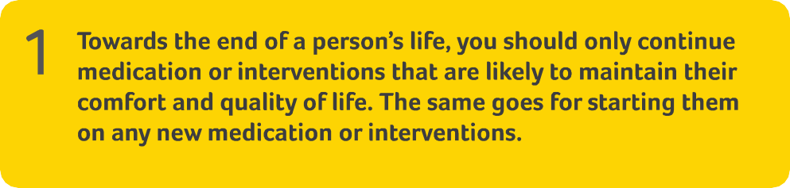
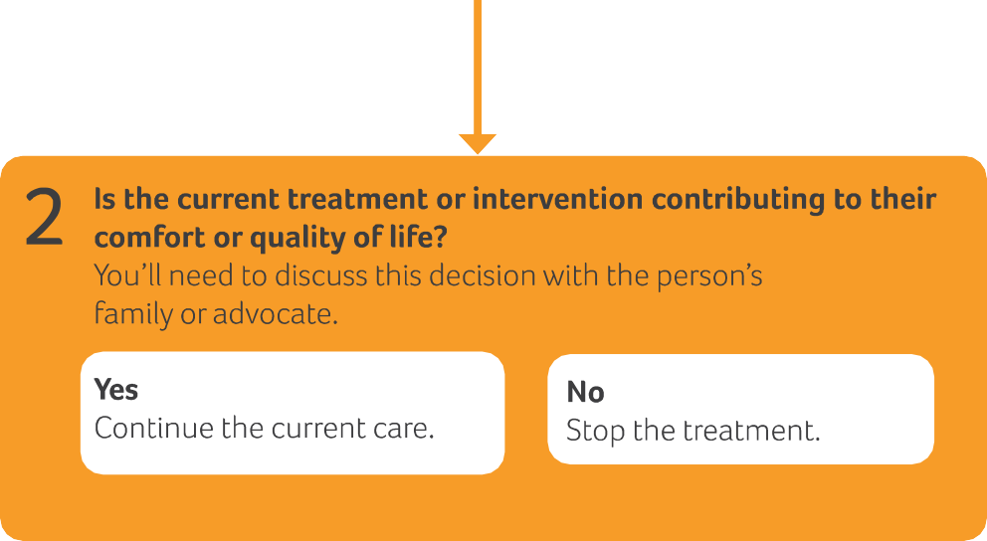
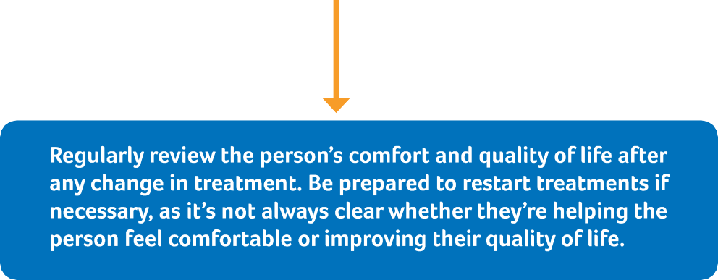

Slide 44
What is a treatment/intervention?
Definition - The use of an agent, procedure, or regimen, such as a drug, surgery, or exercise, in an attempt to cure or mitigate a disease (free-dictionary, 2021)
Can you give some examples?
Regular measurements, medications, physical observations, blood tests, cannulations, blood pressure monitoring

Slide 45
Peter
Peter’s swallowing difficulties continue and he starts to choke when trying to swallow his atorvastatin capsule.
What are the options? Covert medication? Review goals of treatment and stop atorvastatin?
How can we make these decisions?
Benefits risks and burdens
What should we do?

Slide 46

Assessing the overall benefit of treatment options
Weighing the benefits, burdens and risks
The benefits of a treatment that may prolong life, improve a patient’s condition or manage their symptoms must be weighed against the burdens and risks for that patient, before you can reach a view about its overall benefit (GMC, 2020)

Slide 47
Weighing benefits, risks and burdens
Complete activity 3

Slide 48
Advance Care Planning
What you do want to happen
Preferred Priorities for Care document (PPC)
What music I would like to have on in my room
*This is a....
Advance Statement of wishes and preferences
What you do not want to happen
Do Not Attempt Cardio Pulmonary Resuscitation (DNACPR)
I don’t want artificial feeding (formalised)
This is a...
Advanced Directive to Refuse Treatment
Who will speak for you
Lasting Power of Attorney for health and welfare
Nominated proxy spokesperson
*This is a...
Proxy or Lasting Power of Attorney

Slide 49
Peter
As the months go by, Peter continues to lose weight and becomes more frail
His swallow worsens and he is bed bound; GP and care home feel he is reaching the end of his life. His family find this hard to take on board.
All of his medications are discontinued and we start to focus on symptom management: for example pain relief, regular turning and good mouth care
His Treatment Escalation Plan is adjusted to reflect the new priorities of care: not for hospital admission (except for fractures, serious head injuries or intractable symptoms)

Slide 50
The role of the Multi-disciplinary Team (MDT)
How do teams work together?
Resident and family advocate
GSF or palliative care meetings
The weekly ‘home round’ or ‘check in’, with residents prioritised for review based on MDT clinical judgement and care home advice
Referral to other teams or specialists
Developing team with specialist skills (further training, education)
Reflective meetings (example, Significant Event Analysis)

Slide 53

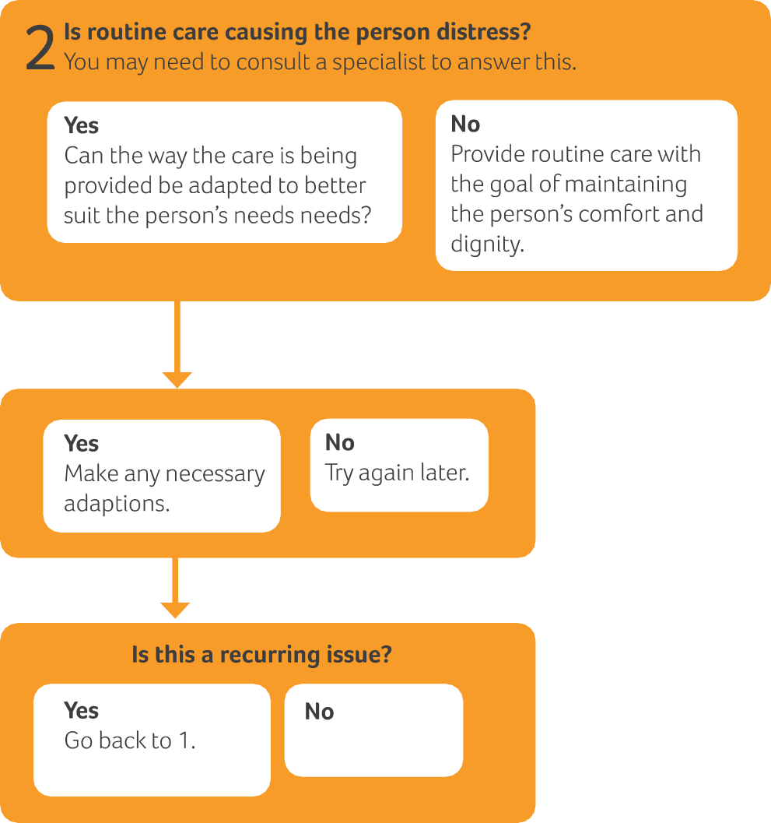

Slide 54
Recognising when a person is dying

Slide 55
Care at the end of life
What is routine care at the end of life?
What is essential?
What if it causes distress?

Slide 56
Routine care at the end of life
Includes:
Oral care
Washing and bathing
Changing bed sheets
Turning to prevent pressure sores or skin irritation
It should always involve kindness and maintaining dignity

Slide 57
Peter
As things progress how can we adapt our care to make it just right for Peter? (Personalisation)
What are the priorities?
Our previous knowledge of him means we know he would like a priest to visit and that he will enjoy some choral music.
His family can visit as often as they wish and staff encourage them to share their memories.
The staff hate to turn Peter when he is peaceful - What are the risks, benefits and burdens?
Who can help?

Slide 59
Rules of Thumb
Conclusion

Slide 60
Reflective practice
Reflective Practice is the foundation of professional development; it makes meaning from experience and transforms insights into practical strategies for personal growth and organisational impact...
Reflective Practice is a way of recognising and articulating what we're learning on a moment by moment basis
(Chartered Institute of Personnel and Development, 2021)

Slide 61
Reflection on practice
Things do not go as planned and one night when agency staff are present Peter chokes on some thickened fluids and an ambulance is called. Peter is taken to hospital and sadly dies in A&E.
This generates a lot of emotion for the family and the staff and Malcolm is very tearful
As part of shared learning a review is planned and all staff involved get a chance to think about what we did well and what we could have done better for Peter
How might you reflect on this case?

Slide 62
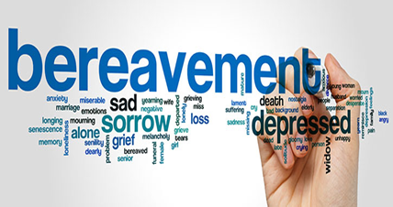
Bereavement
It is an umbrella term for what happens to you due to a loss and includes grief and mourning
Bereavement care is an integral part of good care
Practical advice and support is an important part of this process
The need for support that the grieving person requires will vary depending upon the individual

Slide 63
Dementia (Living) Grief
Unique disease process
“Two” deaths:
A slow psychological receding of the person they know over years
Their loved ones eventual physical death
Compounded loss
Anticipatory grief
Complex experience

Slide 64
Supporting those who are bereaved
Listen to Emma Scattergood’s story – what was helpful for her?
What other things can you think that may help?

Slide 65
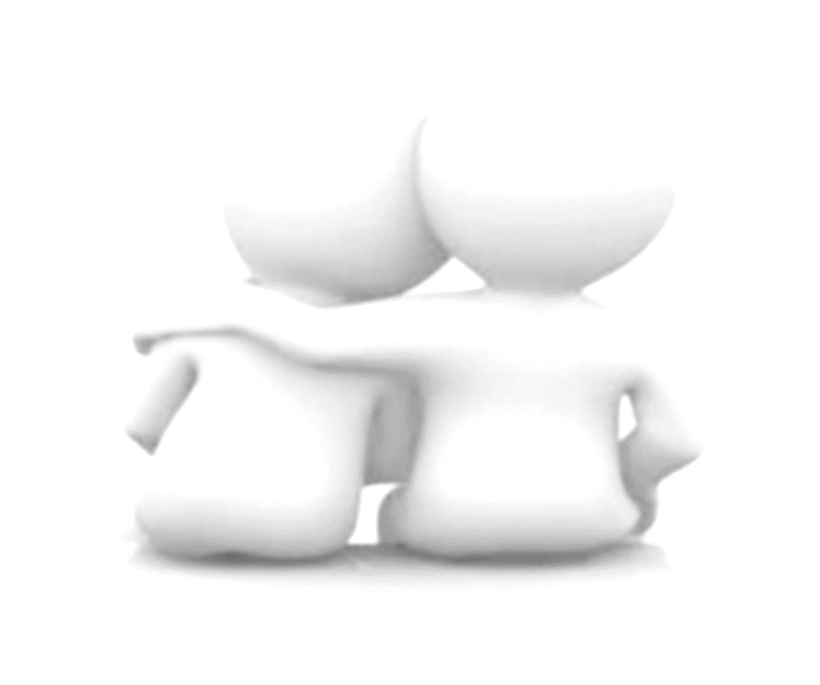
“The most valuable thing nurses can give bereaved relatives is time. Whilst this is a precious commodity, the value of just being there can never be under estimated”
Kinghorn and Duncan, 2005
Notes:
.

Slide 66
Activity 5 Reflection and personal action plan

Slide 67
Thank you for taking part in the session…
We would really appreciate any feedback that you have through the online evaluation form
You can complete the form at https://forms.office.com/r/ceiVkCZ26V

