Slide 1
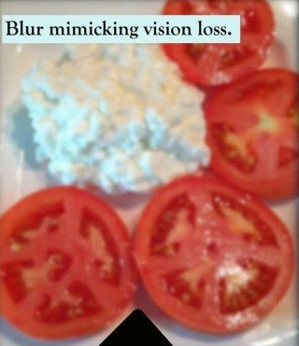
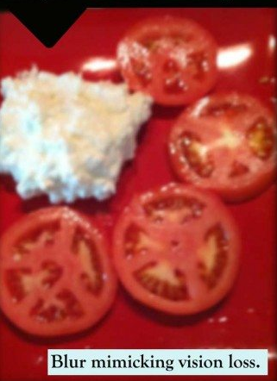
Red plates
Notes:
http://www.homesweethomecareinc.com/caregiver-helpers/red-plates-for-dementia/

