Slide 1
N.B
The PowerPoint presentations included in this programme are for guidance only and facilitators/educators have permission to use their own ensuring the content and outcomes of the programme are met.
Disclaimer: It is the responsibility of the provider organisation and those delivering the programme to ensure educators/facilitators have the appropriate skills, knowledge and competencies to deliver the programme and support the organisations undertaking the programme.

Slide 2

The North West End of Life Care Programme for Care Homes
Step 6 workshop
Step 6 workshop

Slide 3
Objectives
Identify good practice for care of the deceased resident
Respect individual faiths and beliefs to address an individual’s wishes
Be able to provide information to families, significant others, staff and other residents
Recognise the importance of, and offer, bereavement support to families, significant others, staff and other residents

Slide 4
Plan of session
Welcome back and recap on Step 5
Care of residents following death
Bereavement support
Future planning

Slide 5
Care of the deceased person
Last offices
Death must be verified before last offices can commence (Nurse Verification of Expected Death)
Is there a need for referral to the coroner?
Discuss any preferences with family i.e. religious or cultural requests
Collect all equipment necessary
Ensure privacy & dignity maintained
Referral to coroner means all equipment must be left in situ

Slide 6
Documentation and legalities
Check requirements
Document everything
Allow for family time and support
Prompt family to inform funeral director
Ensure other agencies are informed of the death as appropriate i.e. DN, GP, Macmillan team

Slide 7
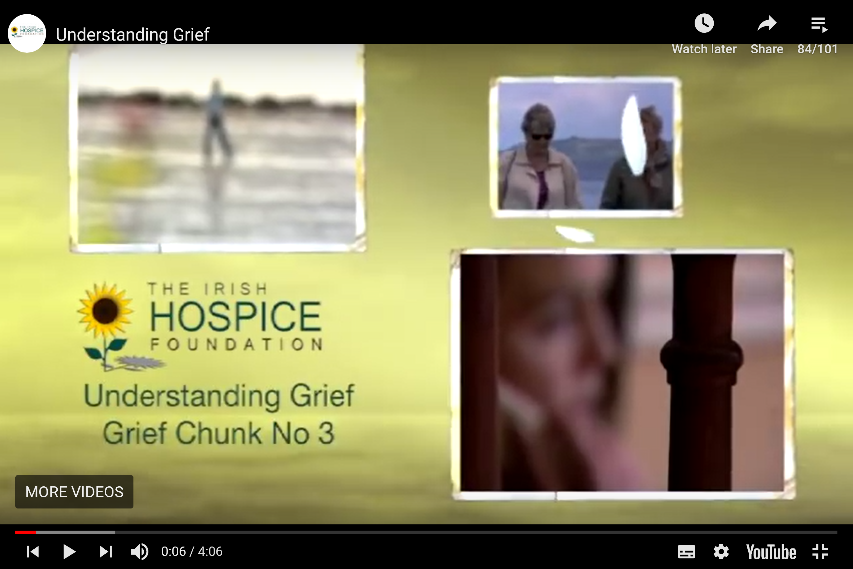
Notes:
https://www.youtube.com/watch?v=6sA4Yyq2f3w

Slide 8
What do we know about grief (different ‘models’)?
The stages:
Denial
Anger
Bargaining
Depression
Acceptance

Slide 9
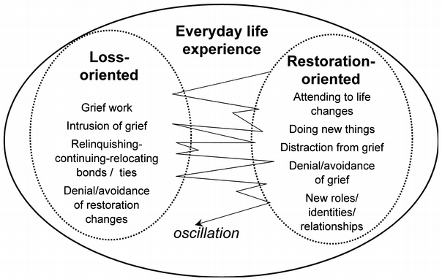
What do we know about grief?
Oscillation:
Normal grief
Chronic grief
Absent or inhibited grief
Disturbed oscillation:
Traumatic grief

Slide 10
And…
High risk of increased morbidity and mortality
Based on:
Experience of death
Supportive network

Slide 11
‘Normal’ and ‘complicated’ grief
Normal Grief
Found in the majority of survivors
It describes grief that is eventually lessened as a person readjusts to their loss
Grief is usually not something one “recovers” from because the loss is never regained or replaced
A grieving individual doesn’t return to the person they were before the loss; rather they usually describe their lives after loss as “different”
For some, it changes their entire identity and they will divide their lives into “before” the loss and “after” the loss

Slide 12
Complicated grief
Complicated grief, sometimes referred to as abnormal grief, is found in only 3 to 25 percent of loss survivors
Chronic grief – the grieving person has trouble finding closure and returning to normal activities over an extended amount of time
Delayed grief – the intentional postponement of grief
Disenfranchised grief – often occurs when a grieving person’s loss can’t be openly acknowledged or is one that society does not accept as a real. Examples include losses related to AIDS, miscarriage, or loss of a homosexual partner
Exaggerated grief – intense reactions of grief
Sudden grief – when death takes place very suddenly without warning. Sudden grief can lead to posttraumatic stress disorder (PTSD)

Slide 13
What can we do?
Offer bereavement support and information to the family and significant others

Slide 14

What kind of information might people need?

Slide 15
Remembrance
Book
Garden
Remembrance Service
Follow up contact or visit
Any other ideas?

Slide 16
A bereavement policy/ statement?
What the bereaved person is entitled to
The responsibilities of the organisation
How the organisation aims to meet these aspects

Slide 17
The Portfolio
Collecting evidence
Sorting evidence
CQC evidence
On-going resource

Slide 18
To conclude...
Any questions???
Mapping today’s session to the portfolio
Stepping off
Evaluation forms

