Slide 1
N.B The PowerPoint presentations included in this programme are for guidance only and facilitators/educators have permission to use their own ensuring the content and outcomes of the programme are met.
Disclaimer: It is the responsibility of the provider organisation and those delivering the programme to ensure educators/facilitators have the appropriate skills, knowledge and competencies to deliver the programme and support the organisations undertaking the programme.

Slide 2
The North West End of Life Care Programme for Care Homes
Step 4 workshop

Slide 3
Objectives
Able to recognise environmental factors required for high quality end of life care
Staff are able to support resident’s needs at the end of life with dignity and compassion
Staff are able to recognise and support resident’s individual spiritual and religious needs
Staff are prepared and supported to provide end of life care
Identify a training plan for all staff in end of life care

Slide 4
Plan of session
Welcome back and recap on Step 3
Environmental factors for high quality end of life care
Dignity and Compassion
Spiritual and religious needs
Preparing and supporting staff to deliver quality end of life care

Slide 5
What IS quality care?

Slide 6
How do we know that we deliver quality care?
Notes:
How do we know we are providing high quality care?? What systems are in place to help us measure quality of care?

Slide 7
High Quality Care - How?
Environment
Dignity
Training and support
Notes:
How do we make sure or ‘CAN’ we make sure we are meeting the standards expected? Is it enough to meet minimum expectations at end of life? Or should we be developing culture where learning and development in terms of EOLC runs right through the organisation? EOLC Vision?

Slide 8
Environment
Fit for purpose...
Comfort
Dignity
Privacy
Safety
Adequate temperature, lighting, ventilation
Adequate space (for care delivery)
INDIVIDUAL CHOICE
Notes:
Discuss the challenges with environments in a person’s own home and how the care worker is able to balance this with individual preference and choice

Slide 9
Dignity
“Dignity is concerned with how people feel, think and behave in relation to the worth or value of themselves and others.
To treat someone with dignity is to treat them as being of worth, in a way that is respectful of them as valued individuals.”
Royal College of Nursing
Notes:
Watch selected EOLC/dignity film and discuss

Slide 10
Dignity in EoL Care
Support people to have as much control over decisions, care and treatment as possible
Support people to die where they want and in a way that they choose
Provide support to minimise pain and suffering
Ensure staff are open to talking to people who wish to discuss issues around their death and that they have the training and skills to respond appropriately
Help people to plan and to say goodbye to loved ones
Allow people time for reflection and provide professional support where needed
Encourage, as far as possible, meaningful activity and discussion to support a sense of self-worth and purpose
Ensure you are fully aware of peoples cultural and religious preferences when providing end of life care – should be Ensure you are fully aware of people’s cultural and religious preferences when providing end of life care
Provide support for family and carers
Provide support for those receiving care who may experience bereavement from the death of friends and peers
SCIE (Social Care Institute for Excellence)

Slide 11
Become a ‘Dignity Champion’
Stand up and challenge disrespectful behaviour
Act as a good role model by treating other people with respect, particularly those who are less able to stand up for themselves
Speak up about Dignity to improve the way that services are organised and delivered
Influence and inform colleagues
Listen to and understand the views and experiences of citizens
www.dignityincare.org.uk
Social Care Institute for Excellence
Notes:
Handouts – promote becoming a Dignity Champion via website link

Slide 12
Family/ carers and significant others
Roles
Participation/involvement
Limitations
Awareness and understanding
Preparation for end of life changes
Feedback
Notes:
Include individual’s choice – do they want family/carers/significant others involved?

Slide 13
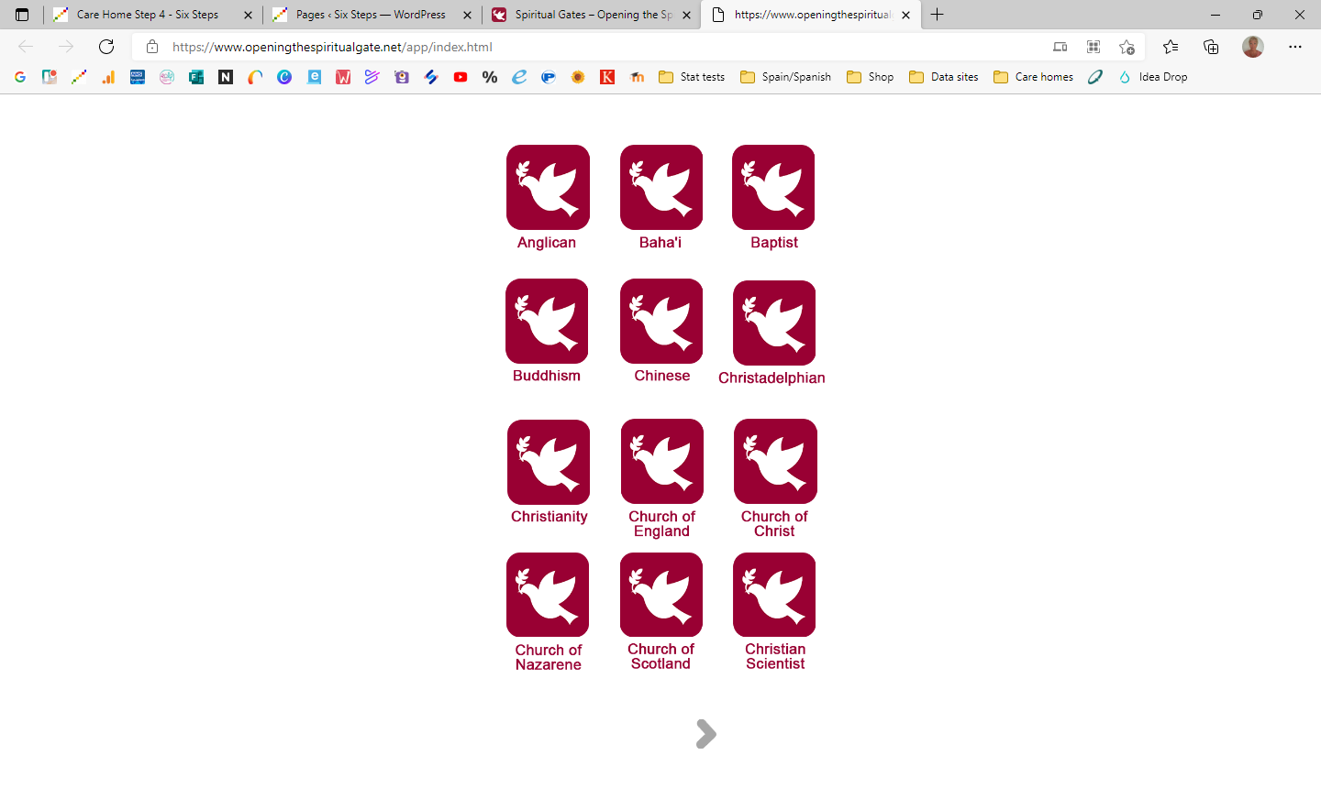
Spiritual support
What different needs can you think about?
How are these needs addressed?
What might your role be?
Religious needs resource
https://www.openingthespiritualgate.net/app/index.html
Notes:
Think more broadly than religious

Slide 14
Education, training and support
What education, training and skills are needed in end of life care, within the care home setting?
Notes:
Posed question – list responses on flipchart / white board
Discuss

Slide 15
Education and training opportunities
Formal courses
Online learning
In-house training
Reflection on practice
Supervision and feedback
Independent learning
Notes:
Discuss

Slide 16
Training plans
Think about the different groups of staff in your home
How would you devise a training plan to meet all their needs?
What topics would you include?
Who would deliver the training?
When and how would that happen?
Consider as many types of training as you can

Slide 17
Development in EOLC
End of Life Care
Communication Skills
Care Planning & Assessment
Mental Capacity Act
Dignity
Symptom Awareness
Equality & Diversity
End of Life Care Plan
Condition Awareness
Syringe Driver Awareness
Record keeping
Advance Care Planning
Notes:
Facilitator to identify that education, training and skills are broad and may be led or responsive to individuals within their care remit, or may be more generalised foundations of care

Slide 18
To conclude...
Any questions???
Mapping today’s session to the portfolio
Next time – ‘To do’ list
Evaluation forms

