Slide 1
N.B
The PowerPoint presentations included in this programme are for guidance only and facilitators/educators have permission to use their own ensuring the content and outcomes of the programme are met.
Disclaimer: It is the responsibility of the provider organisation and those delivering the programme to ensure educators/facilitators have the appropriate skills, knowledge and competencies to deliver the programme and support the organisations undertaking the programme.

Slide 2

The North West End of Life Care Programme for Care Homes
Step 3 workshop

Slide 3
Objectives
Be proactive in the promotion of collaborative working
Recognise the importance of sharing information with the wider multidisciplinary team
Staff are able to deal with situations with challenging communication issues
Define and implement the role of the end of life care champion
To have a system in place to reflect on any significant events that have occurred

Slide 4
Plan of session
Welcome back and recap on Step 2
Collaborative working and sharing information
Challenging communication issues
Developing the role of the Six Steps Champion/ Representative
Significant Event Analysis

Slide 5
Co-ordination of Care
Co-ordination – who is involved???
Need to be aware of available services
Co-ordination is a major activity
Whose responsibility? - Can take away from direct delivery of care
Lack of co-ordination = Increased chance of dying in a place not of individual’s choice

Slide 6
North West Model for Life Limiting Conditions good practice guide
Stable
Gradual Decline
Rapid decline
Last Days of Life
Care After Death
Person diagnosed with life-limiting condition; treatable symptoms, but incurable
Supportive care to help prevent or manage adverse effects of disease and/or treatment
Offer ACP discussion to put PCSP in place; consider how soon/how likely capacity may be lost; may include CPR discussion
Record EPACCS / equivalent, with consent
Benefits review for person and carers: e.g. grants, prescription exemption, Blue Badge scheme
Consider any possible crises; agree anticipatory clinical plan with the person / those important to them
Monitor and support; consider timely referral to other specialist services
ICD discussion about possible future deactivation, if applicable
Early Identification guides:
Primary care– EARLY
Care Homes—Six Steps / Shadow
NEWS2
Person identified as deteriorating despite optimal therapeutic management of underlying medical condition(s)
Exclude reversible causes of deterioration; investigate and treat as appropriate
Include on primary care supportive/ palliative care register; review regularly
District Nurse referral for assessment of care needs (if at home)
Consider if the care is still in line with PCSP, or offer an ACP discussion to put PCSP in place; may include TEPs and CPR discussion
Record EPaCCS or equivalent, with consent (Data Protection)
Share important clinical and social information with all health and social care professionals
Benefits review for person and carers: e.g. DS1500, attendance allowance
Early identification of symptoms and holistic needs
Consider referral to other services based on needs assessment
Consider Continuing Health Care Funding
ICD discussion, if applicable
Person identified as in rapid decline despite optimal therapeutic management of underlying medical condition(s)
Exclude reversible causes of deterioration; investigate and treat as appropriate
Review - supportive/palliative care meeting
Discuss and prescribe anticipatory medication
District Nurse referral for assessment of care needs (if at home)
Enable rapid discharge to PPC/PPD (if in hospital)
Monitor frequently, consider any possible crises; ensure people have contact details of who to call in time of crisis
Review, or offer, ACP discussion to put PCSP in place; record EPaCCS or equivalent with consent
Consider Continuing Health Care funding
Consider DS1500
Assessment of equipment needs
ICD discussion/deactivation, if applicable
CPR considered/discussed; document conversation and decision
Share information with OOH/NWAS, include CPR status and ACP; update EPaCCS
Refer to other specialist services as needed
MDT agree person is in the last days of life—NICE guidance
Exclude reversible causes of deterioration; investigate and treat as appropriate
Agree individual plan of care for the dying person, supported by local documentation, coordinated and delivered with compassion; review regularly Priorities for care of the dying person / One Chance to Get it Right
Anticipatory medication prescribed and authorized for use by MDT
Monitor frequently, consider any possible crises; ensure people have contact details of who to call in time of crisis
Implement care of the dying nursing interventions
ICD discussion and deactivation if not previously initiated
Community patients: share information about expected death with OOH/NWAS, include CPR status and ACP; update EPaCCS
Sensitive communication with carers/family, including what to expect when someone is dying
Respect and support cultural/religious faith customs
Verification of death
Medical Certification of death
Respect and support cultural/religious faith customs
Post death reporting: Notifiable diseases, Significant Event Analysis, Coroner referral
Family, carers and those important to the person offered practical and emotional support (signpost to bereavement services)
What to do after a death: https://www.gov.uk/when-someone-dies
Update supportive/palliative care record and EPaCCS with date and place of death
Inform all relevant agencies: CCG, GP, social care, ambulance service, OOH, Specialist Palliative Care Team, Allied Health Professionals, equipment store
Timely debrief and identify if staff support required

Slide 7
Review sheet
NB This is an abbreviated version of the full document – see website for full version

Slide 8
The role of the key worker
A person who with the patients consent and agreement takes a key role in co-ordinating the patient’s care and promoting continuity, ensuring the patient knows who to access for information and advice

Slide 9

Sharing Information
Changes in condition:
Staff
Family members
GP
District nurses
Other health professionals
Single Point of Access/OOH
Continuing healthcare (funding)
Do you have a ‘key contacts’ list (office/staff)?

Slide 10
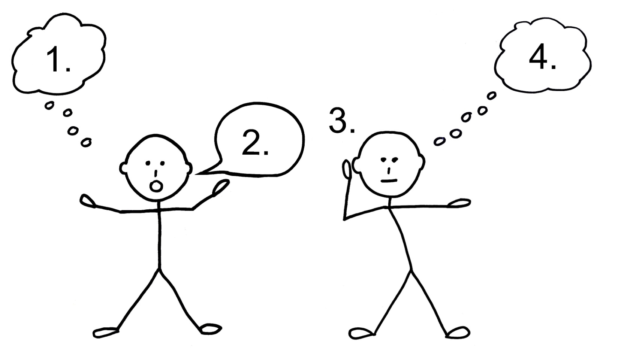
Co-ordination within the organisation
Why is good communication important to good end of life care?
Notes:
Think both for residesnts

Slide 11
Challenging communications
What skills do we need?
Non-verbal awareness
Giving time
Appearing approachable/willing
Being able to cope (or looking like it)
Intuition
Confidence
Acceptance that we wont always get it right, but willingness to try

Slide 12
Challenging communications
What verbal skills do we need?
Active listening
Acknowledging
Encouraging
Picking up of cues
Reflection
Questioning- use of open, directive questions increases disclosure of patient concerns
Clarifying
Empathy
Confronting/challenging
Information giving

Slide 13
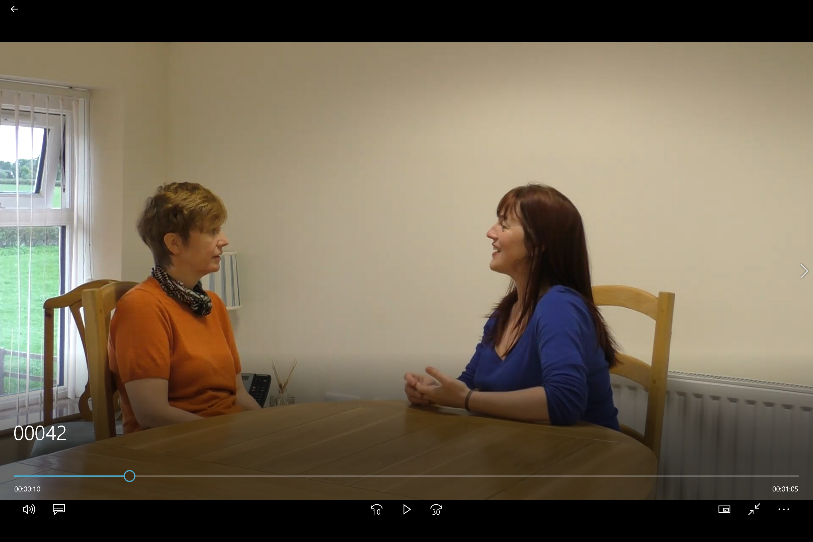
Meet Liz

Slide 14
Significant event analysis (SEA)
The importance of reflection

Slide 15
Significant Event Analysis
Group activity:
In groups discuss a recent end of life care event. Make notes on the Significant Event Analysis template.
Be ready to feedback to the group
Notes:
Engineered groups of 3-4 (depending on size of overall group)
Significant event template on A3 if possible for each group.
After feedback display the charts for participants to review at break

Slide 16
To conclude...
Any questions???
Mapping today’s session to the portfolio
Next time – ‘To do’ list
Evaluation forms

