Slide 1
N.B
The PowerPoint presentations included in this programme are for guidance only and facilitators/educators have permission to use their own ensuring the content and outcomes of the programme are met.
Disclaimer: It is the responsibility of the provider organisation and those delivering the programme to ensure educators/facilitators have the appropriate skills, knowledge and competencies to deliver the programme and support the organisations undertaking the programme.

Slide 2

The North West End of Life Care Programme for Care Homes
Step 2 workshop
Step 2 workshop

Slide 3
Objectives
Recognise the importance of the assessment, planning and review of holistic care
Be able to provide individualised Advance Care Planning to support residents wishes
Understand the implications of the Mental Capacity Act, Best Interest Decision Making and Lasting Power of Attorney

Slide 4
Plan of session
Welcome back and recap on Step 1
Holistic assessment
Advance Care Planning
Decision making for those who lack capacity

Slide 5
What does holistic mean to you?

Slide 6
What is an holistic assessment?
Definition of ‘holistic’
“An holistic assessment is one which not only looks at the physical aspects of a person, but looks also at the psychological, social and spiritual aspects”

Slide 7
Holistic assessment
Is a continuous process & leads to:
More effective care and treatment of symptoms
More client-centred (client’s priority)
Improves communication between all professionals involved with care
Improves evaluation of treatments
Reassures/includes client’s family
Improves the client’s quality of life

Slide 8
The whole person?
PHYSICAL
PSYCHOLOGICAL
SPIRITUAL
SOCIAL

Slide 9
An example is ‘total pain’
Emotional &
Psychological
Physical
‘TOTAL PAIN’
Social
Personal & Spiritual

Slide 10
Assess, plan, implement, evaluate
NB This is an abbreviated version of the full document – see website for full version

Slide 11
North West Model for Life Limiting Conditions good practice guide
Stable
Gradual Decline
Rapid decline
Last Days of Life
Care After Death
Person diagnosed with life-limiting condition; treatable symptoms, but incurable
Supportive care to help prevent or manage adverse effects of disease and/or treatment
Offer ACP discussion to put PCSP in place; consider how soon/how likely capacity may be lost; may include CPR discussion
Record EPACCS / equivalent, with consent
Benefits review for person and carers: e.g. grants, prescription exemption, Blue Badge scheme
Consider any possible crises; agree anticipatory clinical plan with the person / those important to them
Monitor and support; consider timely referral to other specialist services
ICD discussion about possible future deactivation, if applicable
Early Identification guides:
Primary care– EARLY
Care Homes—Six Steps / Shadow
NEWS2
Person identified as deteriorating despite optimal therapeutic management of underlying medical condition(s)
Exclude reversible causes of deterioration; investigate and treat as appropriate
Include on primary care supportive/ palliative care register; review regularly
District Nurse referral for assessment of care needs (if at home)
Consider if the care is still in line with PCSP, or offer an ACP discussion to put PCSP in place; may include TEPs and CPR discussion
Record EPaCCS or equivalent, with consent (Data Protection)
Share important clinical and social information with all health and social care professionals
Benefits review for person and carers: e.g. DS1500, attendance allowance
Early identification of symptoms and holistic needs
Consider referral to other services based on needs assessment
Consider Continuing Health Care Funding
ICD discussion, if applicable
Person identified as in rapid decline despite optimal therapeutic management of underlying medical condition(s)
Exclude reversible causes of deterioration; investigate and treat as appropriate
Review - supportive/palliative care meeting
Discuss and prescribe anticipatory medication
District Nurse referral for assessment of care needs (if at home)
Enable rapid discharge to PPC/PPD (if in hospital)
Monitor frequently, consider any possible crises; ensure people have contact details of who to call in time of crisis
Review, or offer, ACP discussion to put PCSP in place; record EPaCCS or equivalent with consent
Consider Continuing Health Care funding
Consider DS1500
Assessment of equipment needs
ICD discussion/deactivation, if applicable
CPR considered/discussed; document conversation and decision
Share information with OOH/NWAS, include CPR status and ACP; update EPaCCS
Refer to other specialist services as needed
MDT agree person is in the last days of life—NICE guidance
Exclude reversible causes of deterioration; investigate and treat as appropriate
Agree individual plan of care for the dying person, supported by local documentation, coordinated and delivered with compassion; review regularly Priorities for care of the dying person / One Chance to Get it Right
Anticipatory medication prescribed and authorized for use by MDT
Monitor frequently, consider any possible crises; ensure people have contact details of who to call in time of crisis
Implement care of the dying nursing interventions
ICD discussion and deactivation if not previously initiated
Community patients: share information about expected death with OOH/NWAS, include CPR status and ACP; update EPaCCS
Sensitive communication with carers/family, including what to expect when someone is dying
Respect and support cultural/religious faith customs
Verification of death
Medical Certification of death
Respect and support cultural/religious faith customs
Post death reporting: Notifiable diseases, Significant Event Analysis, Coroner referral
Family, carers and those important to the person offered practical and emotional support (signpost to bereavement services)
What to do after a death: https://www.gov.uk/when-someone-dies
Update supportive/palliative care record and EPaCCS with date and place of death
Inform all relevant agencies: CCG, GP, social care, ambulance service, OOH, Specialist Palliative Care Team, Allied Health Professionals, equipment store
Timely debrief and identify if staff support required

Slide 12

Tools
Do you have any examples of tools you use for assessment?

Slide 13
Assessment Tools
Skin Breakdown – Braden/Waterlow
Oral Assessment
HOPE - Spiritual assessment
Pain
Fluids
Bowels

Slide 14
Advance Care Planning
What is a good death in relation to a resident’s choices and decision making?

Slide 15
What is Advance Care Planning
A voluntary process of discussion about future care between an individual and their care providers, irrespective of discipline. If the individual wishes, their family and friends may be included. It is recommended, with the individuals agreement, that this discussion is documented, regularly reviewed, and communicated to key persons involved in their care

Slide 16
Diagram to explain Advance Care Planning
Formalises what individuals and their
family do wish to happen to them
Can be useful to clinicians in planning
of individual’s individual care
Not legally binding and may also need
Advance Decision
ADVANCE
STATEMENT
ADVANCE
CARE
PLANNING
Formalises what individuals do not wish
to happen to them
Legally binding document, eg (Advance
Decision to Refuse Treatment (ADRT)
and/or DNACPR
Related to capacity of decision making-
Mental Capacity Act
ADVANCE
DECISIONS
(Gold Standards Framework)

Slide 17
What to talk about?
Individual’s agenda:
What are the individuals feelings about their illness, what concerns do they have, what goals are they looking to reach, do they understand their illness and its prognosis, do they have particular care preferences, now and in the future?
Tools that may help trigger conversations:
    Thinking about it! Prompt card
    Notice board posters
    Conversations for life cards
    Dying Matters Resources/ Events
    Reminiscence groups/ memory boxes

Slide 18
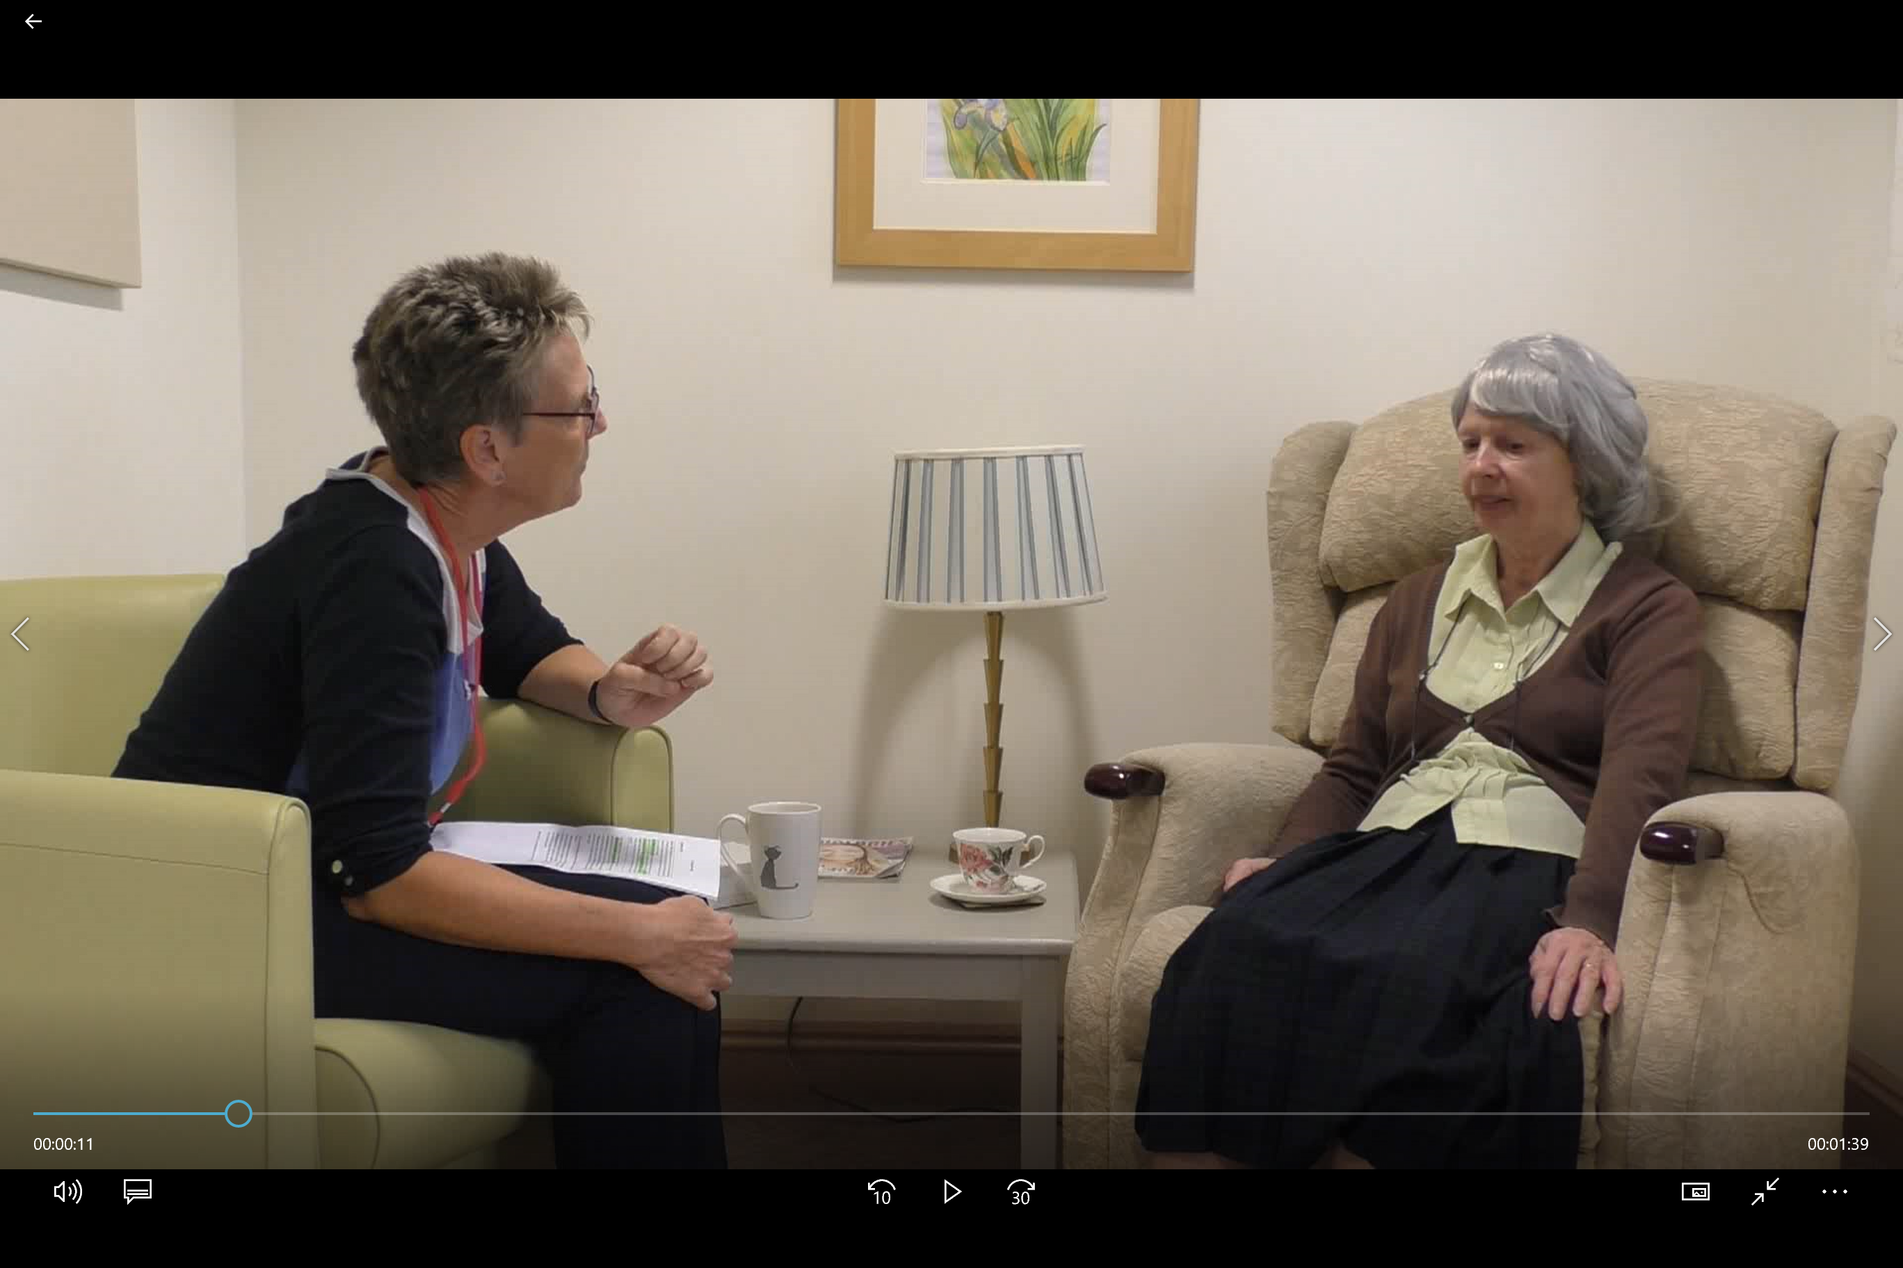
Meet Betty

Slide 19
Documentation
The process of ACP is more important than completing any document
………….but it is important to document any ACP outcomes in the most appropriate way and communicate this with appropriate others.

Slide 20

Preferred Priorities for Care (PPC)

Slide 21
Who completes the PPC?
Person held document, so...
Ideally the individual
Could be a relative with individual input
Could be professional/ carer with individual
Then
Keep it in a visible and easily accessible place
Communicate the presence of a PPC to others involved in their care
Take any necessary actions

Slide 22

Supporting resources
Version for use with individuals who have communication difficulties i.e. Learning disabilities, early dementia
Provides simple information around:
  Lasting Power of Attorney
  Advance Decisions to Refuse Treatment
  Advance Care Plans
Good way to test the water

Slide 23
The Mental Capacity Act (2005)
Mental Capacity Act (MCA) 005
Choice and decision- making by, and on behalf of, people with impaired mental capacity
  5 Core Principles
  Best Interest Decisions
  Independent Mental Capacity Advocates (IMCA’s)
  Advance Decision to Refuse Treatment (ADRT)
  Appointment of a Lasting Power of Attorney (LPA)

Slide 24
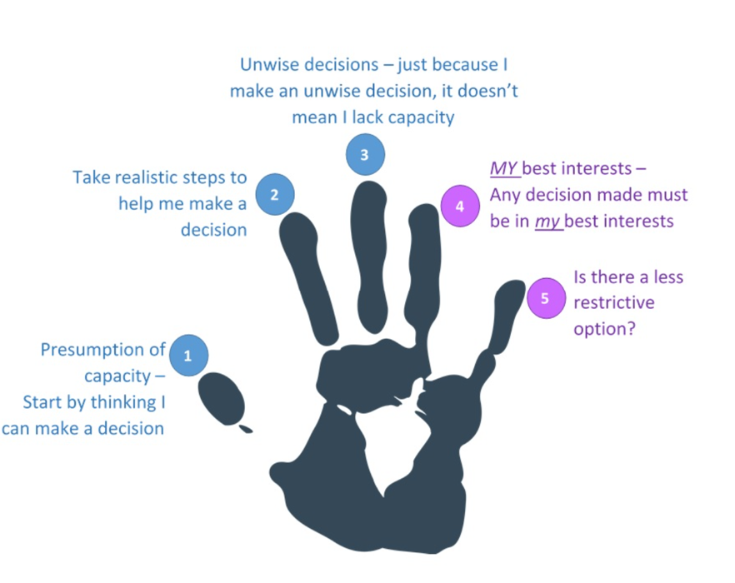
Five core principles of the MCA

Slide 25
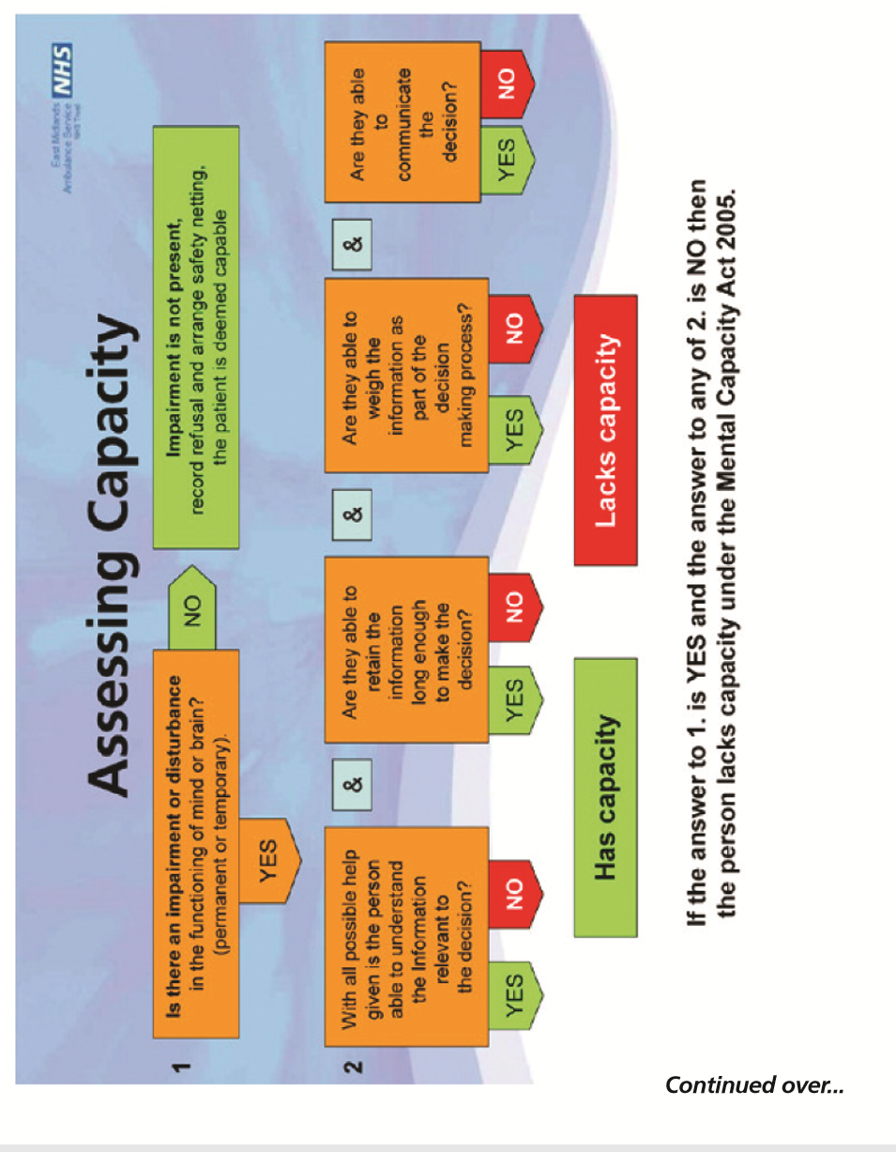
Assessing capacity

Slide 26
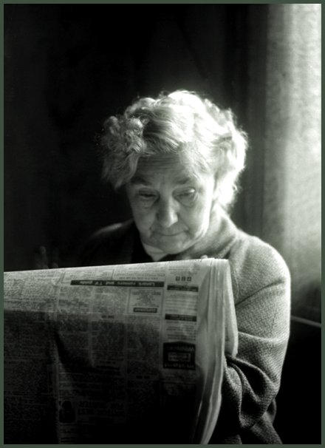
Decision making for those who lack capacity
Let’s have a go using a case study
DORIS

Slide 27
To conclude...
Any questions???
Mapping today’s session to the portfolio
Next time – ‘To do’ list
Evaluation forms

