Slide 1
N.B
The PowerPoint presentations included in this programme are for guidance only and facilitators/educators have permission to use their own ensuring the content and outcomes of the programme are met.
Disclaimer: It is the responsibility of the provider organisation and those delivering the programme to ensure educators/facilitators have the appropriate skills, knowledge and competencies to deliver the programme and support the organisations undertaking the programme.

Slide 2

The North West End of Life Care Programme for Care Homes
Step 1 workshop

Slide 3
Objectives
The care home will have an end of life care statement if they do not already have a statement/policy or guideline in place
Be able to identify how the North West Model for Life Limiting Conditions supports a Supportive Care Record leading to the recognition of residents who may be in the final year of life
Be able to identify when to undertake Advance Care Planning discussions

Slide 4
Plan of session
Welcome and introductions
Developing a care home end of life care statement
Introduction to the North West Model for Life Limiting Conditions
What systems need to be in place to identify residents in the last year of life?
Starting a register
Case studies and discussion
Foretelling and Forewarning – when is it appropriate to open/hold discussions?
Case studies and discussion
Next time...

Slide 5
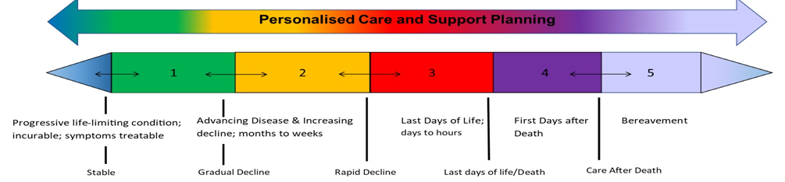
The North West Model for Life Limiting Conditions
Notes:
Explain the model and purpose
Advancing Disease; Change of residence, requiring more assistance, new diagnosis, depression, increased hospital admissions, weight loss, symptoms
Increasing Decline; decreased appetite, withdrawn, increasing weakness and fragility, not strong enough to attend outpatients, decreased mobility, sleeping more often, increased interventions required, gaunt, lack of concentration, fatigue, weight loss.
Last Days of Life; bedbound, inability to take food and drink, unable to take oral medication, drowsy, semi conscious/unconscious, peripherally cyanosed, mottled, full assistance with all care, profound weakness, reduced cognition, difficulty swallowing, changes to breathing, irregular pulse, hallucinations, disorientation

Slide 6
Prognostication or diagnosing dying???
Prognostication Diagnosing dying
‘Forecasting/Foreseeing’
Longer term
Often refers to a 6-12 month period
May link in with GSF and/or ACP
Variable in individuals, but normally in relation to last few days - or week(s)? of life
In line with the commencement of an individualised care plan

Slide 7
What do we need to do to identify
residents in the last year of life?

Slide 8
Why prognosticate?
THE question…“How long do I have to live?”
Help residents, families and professionals to make decisions about the appropriateness of palliative treatments
Provide residents and families with opportunity to think about where they wish to be cared for
Allow time for residents and families to take practical steps to prepare for their own deaths
To enable access to particular resources

Slide 9

How to prognosticate????
There is guidance available, however, the ‘SURPRISE QUESTION’ is often referred to...
The Gold Standards Framework model lists a number of ‘prognostic indictors’, however ‘A Quick Guide to Identifying Patients for Supportive and Palliative Care’ is more concise
Why is it difficult?

Slide 10
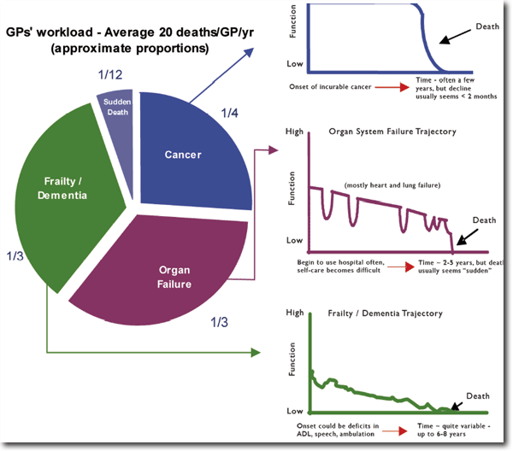
Illness trajectories and our residents

Slide 11
Supportive Care Record
Assessment based on the North West Model | End of Life Care Phases |  |  |  |  |  | Advance Care Plan Record
 | Incurable life limiting condition Stable | 1 Gradual decline | 2 Rapid decline | 3 Last days of life | 4 Care after death | 5 Bereave-ment follow up | Date completed or declined | Review date – record any change | Review date– record any change | Review date– record any change | Review date– record any change | Key worker
Resident’s Name
For example: Jack Smith | 02/01/21 | 01/12/20 | 24/03/21 | 02/04/21 | 05/04/21 | Telephone contact 17/05/21 | 01/12/21 Declined | 24/03/21 PPC Care home | 28/03/21 Care home | 02/04/21 Care home |  | Ann Jones

Slide 12

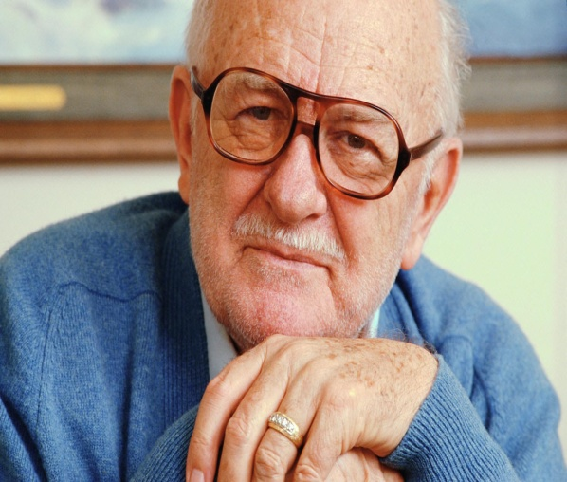
Using the Supportive Care Record
Let’s have a go using case studies
JOAN
DEREK

Slide 13
North West Model for Life Limiting Conditions good practice guide for stable,
gradual decline and rapid decline
Stable
Gradual Decline
Rapid decline
Person diagnosed with life-limiting condition; treatable symptoms, but incurable
Supportive care to help prevent or manage adverse effects of disease and/or treatment
Offer ACP discussion to put PCSP in place; consider how soon/how likely capacity may be lost; may include CPR discussion
Record EPACCS / equivalent, with consent
Benefits review for person and carers: e.g. grants, prescription exemption, Blue Badge scheme
Consider any possible crises; agree anticipatory clinical plan with the person / those important to them
Monitor and support; consider timely referral to other specialist services
ICD discussion about possible future deactivation, if applicable
Early Identification guides:
Primary care– EARLY
Care Homes—Six Steps / Shadow
NEWS2
Person identified as deteriorating despite optimal therapeutic management of underlying medical condition(s)
Exclude reversible causes of deterioration; investigate and treat as appropriate
Include on primary care supportive/ palliative care register; review regularly
District Nurse referral for assessment of care needs (if at home)
Consider if the care is still in line with PCSP, or offer an ACP discussion to put PCSP in place; may include TEPs and CPR discussion
Record EPaCCS or equivalent, with consent (Data Protection)
Share important clinical and social information with all health and social care professionals
Benefits review for person and carers: e.g. DS1500, attendance allowance
Early identification of symptoms and holistic needs
Consider referral to other services based on needs assessment
Consider Continuing Health Care Funding
ICD discussion, if applicable
Person identified as in rapid decline despite optimal therapeutic management of underlying medical condition(s)
Exclude reversible causes of deterioration; investigate and treat as appropriate
Review - supportive/palliative care meeting
Discuss and prescribe anticipatory medication
District Nurse referral for assessment of care needs (if at home)
Enable rapid discharge to PPC/PPD (if in hospital)
Monitor frequently, consider any possible crises; ensure people have contact details of who to call in time of crisis
Review, or offer, ACP discussion to put PCSP in place; record EPaCCS or equivalent with consent
Consider Continuing Health Care funding
Consider DS1500
Assessment of equipment needs
ICD discussion/deactivation, if applicable
CPR considered/discussed; document conversation and decision
Share information with OOH/NWAS, include CPR status and ACP; update EPaCCS
Refer to other specialist services as needed

Slide 14
North West Model for Life Limiting Conditions good practice guide for the last days of life and care after death
Last Days of Life
Care After Death
MDT agree person is in the last days of life—NICE guidance
Exclude reversible causes of deterioration; investigate and treat as appropriate
Agree individual plan of care for the dying person, supported by local documentation, coordinated and delivered with compassion; review regularly Priorities for care of the dying person / One Chance to Get it Right
Anticipatory medication prescribed and authorized for use by MDT
Monitor frequently, consider any possible crises; ensure people have contact details of who to call in time of crisis
Implement care of the dying nursing interventions
ICD discussion and deactivation if not previously initiated
Community patients: share information about expected death with OOH/NWAS, include CPR status and ACP; update EPaCCS
Sensitive communication with carers/family, including what to expect when someone is dying
Respect and support cultural/religious faith customs
Verification of death
Medical Certification of death
Respect and support cultural/religious faith customs
Post death reporting: Notifiable diseases, Significant Event Analysis, Coroner referral
Family, carers and those important to the person offered practical and emotional support (signpost to bereavement services)
What to do after a death: https://www.gov.uk/when-someone-dies
Update supportive/palliative care record and EPaCCS with date and place of death
Inform all relevant agencies: CCG, GP, social care, ambulance service, OOH, Specialist Palliative Care Team, Allied Health Professionals, equipment store
Timely debrief and identify if staff support required

Slide 15
End of Life Care Review Sheet
NB This is an abbreviated version of the full document – see website for full version

Slide 16
Foretelling...
(Discussing end of life wishes)
Do you facilitate ACP discussions?
When would it be appropriate to open discussions about end of life issues?
How can we initiate such discussions?
JOAN
DEREK

Slide 17
Recognising when to start/ undertake ACP discussions
Recognised ‘system’ in the home, so EVERYONE knows where/how wishes are documented
Good teamwork (esp with DNs, GPs, Macmillan Nurses
Consider use of existing format, ie, Preferred Priorities for Care (PPC) or Best Interests (at End of Life)
Promote an ‘open’ attitude to holding discussions with residents and families

Slide 18
To conclude...
Any questions???
Mapping today’s session to the portfolio
Next time – ‘To do’ list
Evaluation forms

