Slide 1
COVID-19 DEMENTIA CARE
Resources Repository For Health And Social Care Professionals
brought together by the Advanced Dementia Support Team: EoLP

Slide 2
CARE HOMES ‘Admission & Care’: Key points from Government guidance Managing resident behaviour Key points from a Psychologist; physical health, communication, anxiety, activities Best interests ~ least restrictive options Advice for conversations with relatives over the phone Click here for Managing the COVID-19 pandemic in care homes
“As part of the national effort, the care sector also plays a vital role in accepting patients as they are discharged from hospital” (DoH, PHE, CQC)

Slide 3
BEHAVIOUR: discussion and advice there is a separate slide set if you wish to print it and take it to carers, please share
Supporting Carers and Care Staff to Understand and Respond to Changes in Behaviour in People with Dementia During the COVID-19 Pandemic
Dr F. Duffy & J Richardson
Northern Health and Social Care Trust
IN THIS DOCUMENT YOU WILL FIND:
Meaningful activity where possible to minimise distress – ideas and links
Paint a smiley face on your PPE mask to help the person feel safer
Remember behaviour and emotion can be communicating a physical health need – a checklist
Advice for residents asking to go home, asking for relatives & others
Personal caring
Thinking about sleep

Slide 4
Admission and Care of Residents During COVID-19 Incident in a Care Home (4 slides)
Find it here: Click Here
Admission of residents
Caring for residents, depending on their COVID-19 status
Reporting of COVID-19 cases
Providing care after death
Advice for staff
Supporting existing residents that may require hospital care
National support available to implement this guidance

Slide 5
Admitting residents from hospital
See Annex D for guidance on people with dementia discharged from hospital following treatment for COVID-19
A Discharge to Assess (D2A) model is in place to streamline the discharge process and the assessment of care needs will be undertaken by hospital discharge teams, in collaboration with Trusted Assessors.

Slide 6
Advice on providing care to asymptomatic residents
If an individual has no COVID-19 symptoms or has tested positive for COVID-19 but is no longer showing symptoms and has completed their isolation period, then care should be provided as normal.
Care home providers should follow social distancing measures for everyone in the care home, wherever possible, and the shielding guidance for the extremely vulnerable group.
Due to resident limited communication skills, staff should be alert to the presence of signs as well as symptoms of the virus. This could include delirium.
Assess each resident twice daily for the development of a fever (≥37.8°C), cough or shortness of breath.

Slide 7
Advice on providing care to residents with symptoms
Any resident presenting with symptoms of COVID-19 should be promptly isolated (details in the full document).
Instigate full infection control measures.
Detail regarding testing is in the full document
If symptoms worsen during isolation or are no better after 7 days, contact their GP for further advice around escalation and to ensure person-centred decision making is followed.
Advice on considering hospital admission is included in this guidance

Slide 8
Care after death
The infection control precautions described in this document continue to apply whilst an individual who has died remains in the care home
Please use resources available here in EPAIGE regarding care after death of your resident

Slide 9
Keep on top of physical health
Click here for : Supporting People with Dementia During Covid-19
Is the person in pain?
Do they have an infection?
Are they experiencing a delirium?
Are they dehydrated?
Are they constipated, incontinent or need to use the toilet?
Do they wear glasses and hearing aid, are these up to date and working?
Does their medication need to be reviewed?
Do they have any long term health conditions which need to be reviewed?
Are they hungry, thirsty, or too cold or hot?
Changes in physical health contribute to changes in behaviour and emotional wellbeing.

Slide 10
Communication
The person with dementia is likely to mirror your mood and behaviour.
Even if you are wearing a mask, the person can see the smile in your eyes.

Slide 11
Day by day activity
Advice:
A routine each day with a variety of activity to help provide a sense of safety and security
Write the daily plan on a white board that is in view.
Tick off each activity when it has finished.
Remember 20 second hand washing
Ensure activity items are thoroughly cleaned before and after use.
Stay connected with family and friends – use Phone, WhatsApp call, video, audio note, Skype and Zoom apps to help. Or just photographs during a call
Ask family to send letters, card, photographs, voice and video messages you can access at regular intervals.
How we spend our day affects how we feel and how we behave.
Activity gives our day structure, occupies us and gives purpose and meaning to life.

Slide 12
…a list of ideas for activity at home
Most people enjoy singing and this has a positive impact on mood.
Offer a balloon to play with.
Play skittles or bowls with a plastic ball.
Choose some objects and pictures or photographs of famous people and engage in reminiscence.
Recite proverbs and poems from childhood for reminiscence.
Play music to “name that song”.
Play a game of colour bingo.
Paint, colour, draw or make cards.
Set up a gardening station at a table.
Offer some activities that do not require active participation, such as listening to music or watching TV, a short audio book.
Steam concerts from YouTube.

Slide 13
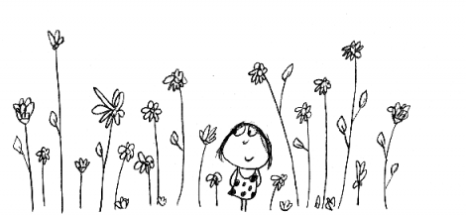
Ideas for isolation
Check in with the person frequently to see how they are and engage in brief conversation.
The person may need help to start an activity.
Try a range of activities to see what they enjoy doing.
Try to create a rummage box.
Offer colouring or puzzles on paper or on a tablet or computer.
Involve the person in tidying, cleaning or sorting cupboards in their room where possible.
Offer photographs, pictures, books and magazines.
Support the person to go outside if possible.

Slide 14
Anxieties.
Anxiety may escalate during the COVID-19 pandemic
The person knows that something is wrong and is missing their usual routine and visitors
Telling someone not to worry or calm down usually doesn’t help.
Support the person to a quieter, calm place if they are distressed.
Talk to the person and ask them what is upsetting them. Acknowledge how they feel, for example “It sounds like you are feeling worried.”
A person with dementia may mirror and reflect your mood and behaviour. If you appear anxious, this may cause the person to feel even more anxious.
Be patient with the person. A warm, positive and friendly approach will help.

Slide 15
When the person is wanting to leave …
Asking the person to come and sit down or telling them they cannot leave is unlikely to help.
Find out where the person wants to go.
Acknowledge how they might be feeling, for example, “You’re worried about your children ……Let’s see if we can find out where they are”
As you walk with them, ask them to help you to do something.
Purposeful activity will reduce the person’s need to leave.
If the person is asking about their children or family they may be missing them. Support them to look at photographs of family if available.
If the person is asking to go to work, tell them that they do not have to go to work today but you need them to help you with a job around the home.

Slide 16
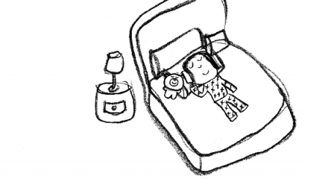
Sleep, important for good health
Some things to consider …
Think about any physical health changes which may be disrupting sleep.
Orientate the person to the time throughout the day.
Reduce daytime naps and avoid caffeine in the evening.
Ensure there is good light during the day and it is sufficiently dark at night.
Ensure the person’s bedroom is not too cold or not too hot.
Ensure their bed is suitable and they have comfortable night wear.
If the person experiences vivid dreams, nightmares or hallucinations at night, listen to them and provide reassurance.
It can sometimes help to support the person out of their room for a short time before supporting back to bed.

Slide 17
Least restrictive options and COVID-19

Slide 18
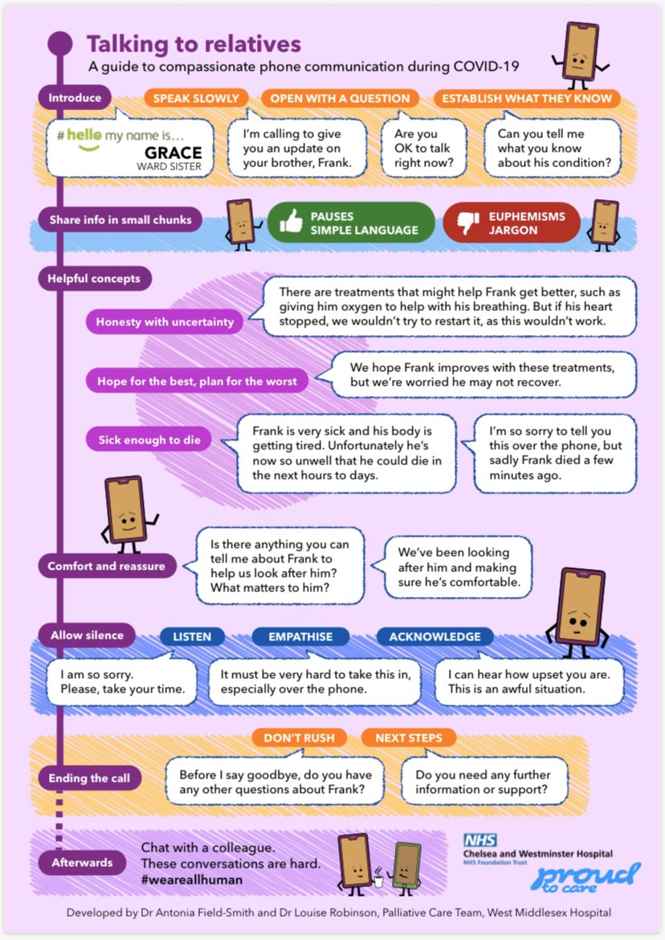
Conversations over the phone

