Slide 1
COVID-19 DEMENTIA CARE
Resources Repository For Health And Social Care Professionals
brought together by the Advanced Dementia Support Team: EoLP

Slide 2
ACUTE CARE SUPPORT BRITISH GERIATRIC SOCIETY GUIDANCE DELIRIUM DECISION MAKING ~ ETHICS DURING COVID DISCUSSING COVID WHEN THE PATIENT HAS DEMENTIA TALKING TO RELATIVES OVER THE PHONE
Useful to acute care, community practice & care homes

Slide 3
British Geriatrics Society (BGS): Good Practice Guide
Key Points
Establish diagnosis where possible
Establish an Advance Care Plan
Be person-centred when you are discussing care
Seek support for distressing symptoms; breathlessness & delirium
Comply with MCA (2015) & Best Interests
Support families
go to:
https://www.bgs.org.uk/resources/covid-19-end-of-life-care-and-dementia

Slide 4
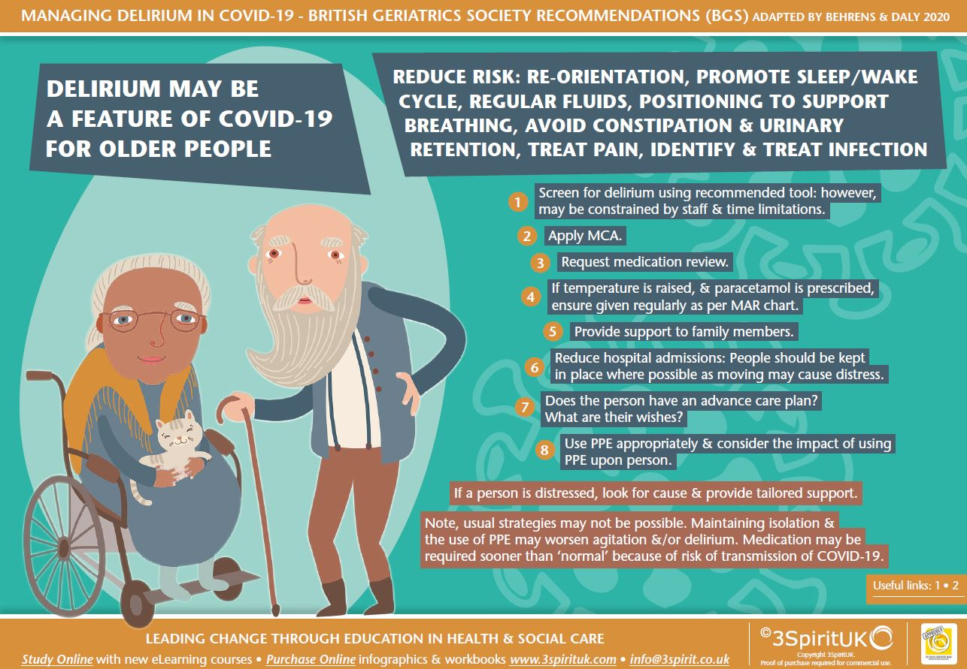

Slide 5
Delirium & Coronavirus: (BGS) https://www.bgs.org.uk/resources/coronavirus-managing-delirium-in-confirmed-and-suspected-cases
Two key themes to the guidance:
1) good general care: prevention, early detection, and non-pharmacological management should be provided as systems allow. 2) because of the ease of transmission of COVID-19, the risk of harm to others may exceed risk of harm to the individual and this may necessitate earlier use of pharmacological treatments for potentially risk behaviour.
General information (HEE ) on Delirium follows… ….

Slide 6
Link to coronavirus managing delirium in confirme and suspected cases

Slide 7
BMA: COVID-19 ETHICAL DECISION MAKING
In the BMA’s view it would be both lawful and ethical to refuse someone potentially life-saving treatment where another current or anticipated patient has a higher priority for the available treatment.
During the peak of the pandemic, it is possible that doctors may be required to assess a person’s eligibility for treatment based on a ‘capacity to benefit quickly basis’
The ethical basis for decisions to restrict ICU admission or to withdraw treatment because of critically short supply are not best interests decisions. These are decisions made on the basis of distributive justice and the ethical importance of trying to benefit as many patients as possible.
In making these decisions doctors should follow accepted local guidance and protocols. Decisions about how resources are allocated must be:
reasonable in the circumstances, including being based on coherent ethical principles and reasoning
based on the best available clinical data and opinion
agreed on in advance where practicable, while recognising that decisions may need to be rapidly revised in changing circumstances
consistent between different professionals as far as possible
communicated openly and transparently
Subject to modification and review as the situation develops

Slide 8
How to communicate the diagnosis
In this video the Doctor discusses the implications of cognitive impairment on discussing the diagnosis of COVID-19

Slide 9
Communication
The person with dementia is likely to mirror your mood and behaviour.
Even if you are wearing a mask, the person can see the smile in your eyes.

Slide 10
Living-with-dementia-and-COVID-19-an-emergency-kit.pdf
Living with dementia and COVID-19: an emergency kit
Rare Dementia Support & UCL Dementia Research Centre have complied a repository for all people affected by dementia
dementia-specific support
legal and financial guidance
at-home activities
advice for carers

Slide 11
BEHAVIOUR: discussion and advice there is a separate slide set if you wish to print it and take it to carers, please share
Supporting Carers and Care Staff to Understand and Respond to Changes in Behaviour in People with Dementia During the COVID-19 Pandemic
Dr F. Duffy & J Richardson
Northern Health and Social Care Trust
IN THIS DOCUMENT YOU WILL FIND:
Meaningful activity where possible to minimise distress – ideas and links
Paint a smiley face on your PPE mask to help the person feel safer
Remember behaviour and emotion can be communicating a physical health need – a checklist
Advice for residents asking to go home, asking for relatives & others
Personal caring
Thinking about sleep

Slide 12
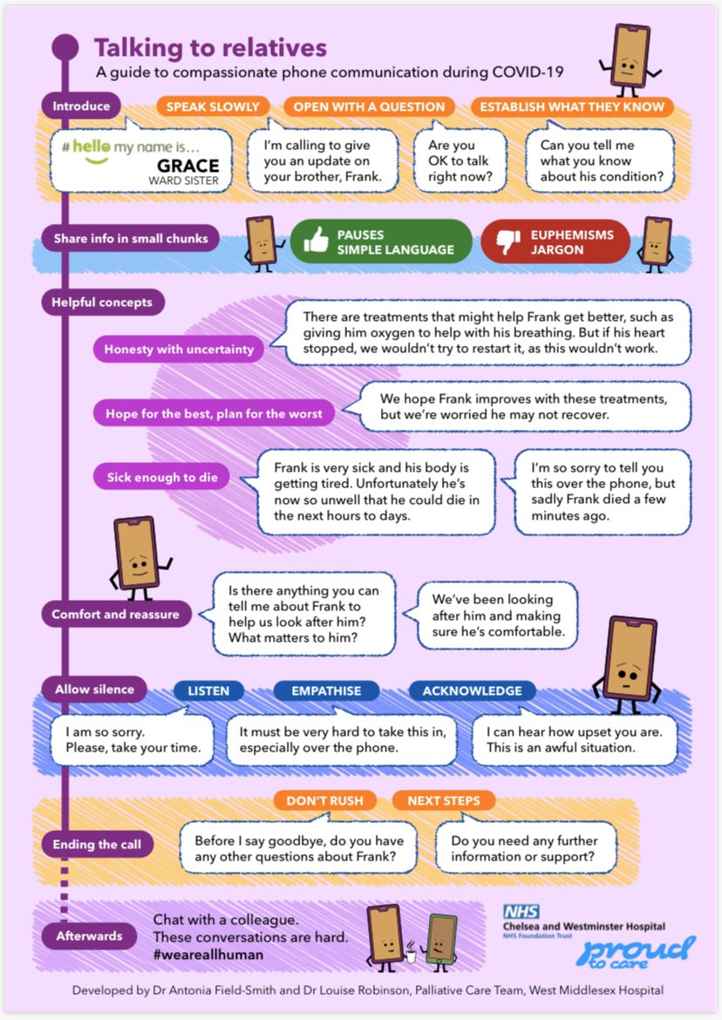
Conversations over the phone

